Slide 1


Dataset Poisoning Detector
Use sparsity techniques to detect if a dataset has been poisoned.
Gruppo n. 8
Daniele Russo – 0001186664 Nicola Modugno – 0001176883

Slide 2
General context
The security industry is increasingly using ML models to detect malware.
In particular, ML models are trained using static features extracted from files.
These models serve as a first line of defense (pre-execution detection) but are vulnerable to increasingly sophisticated attacks.

Slide 3

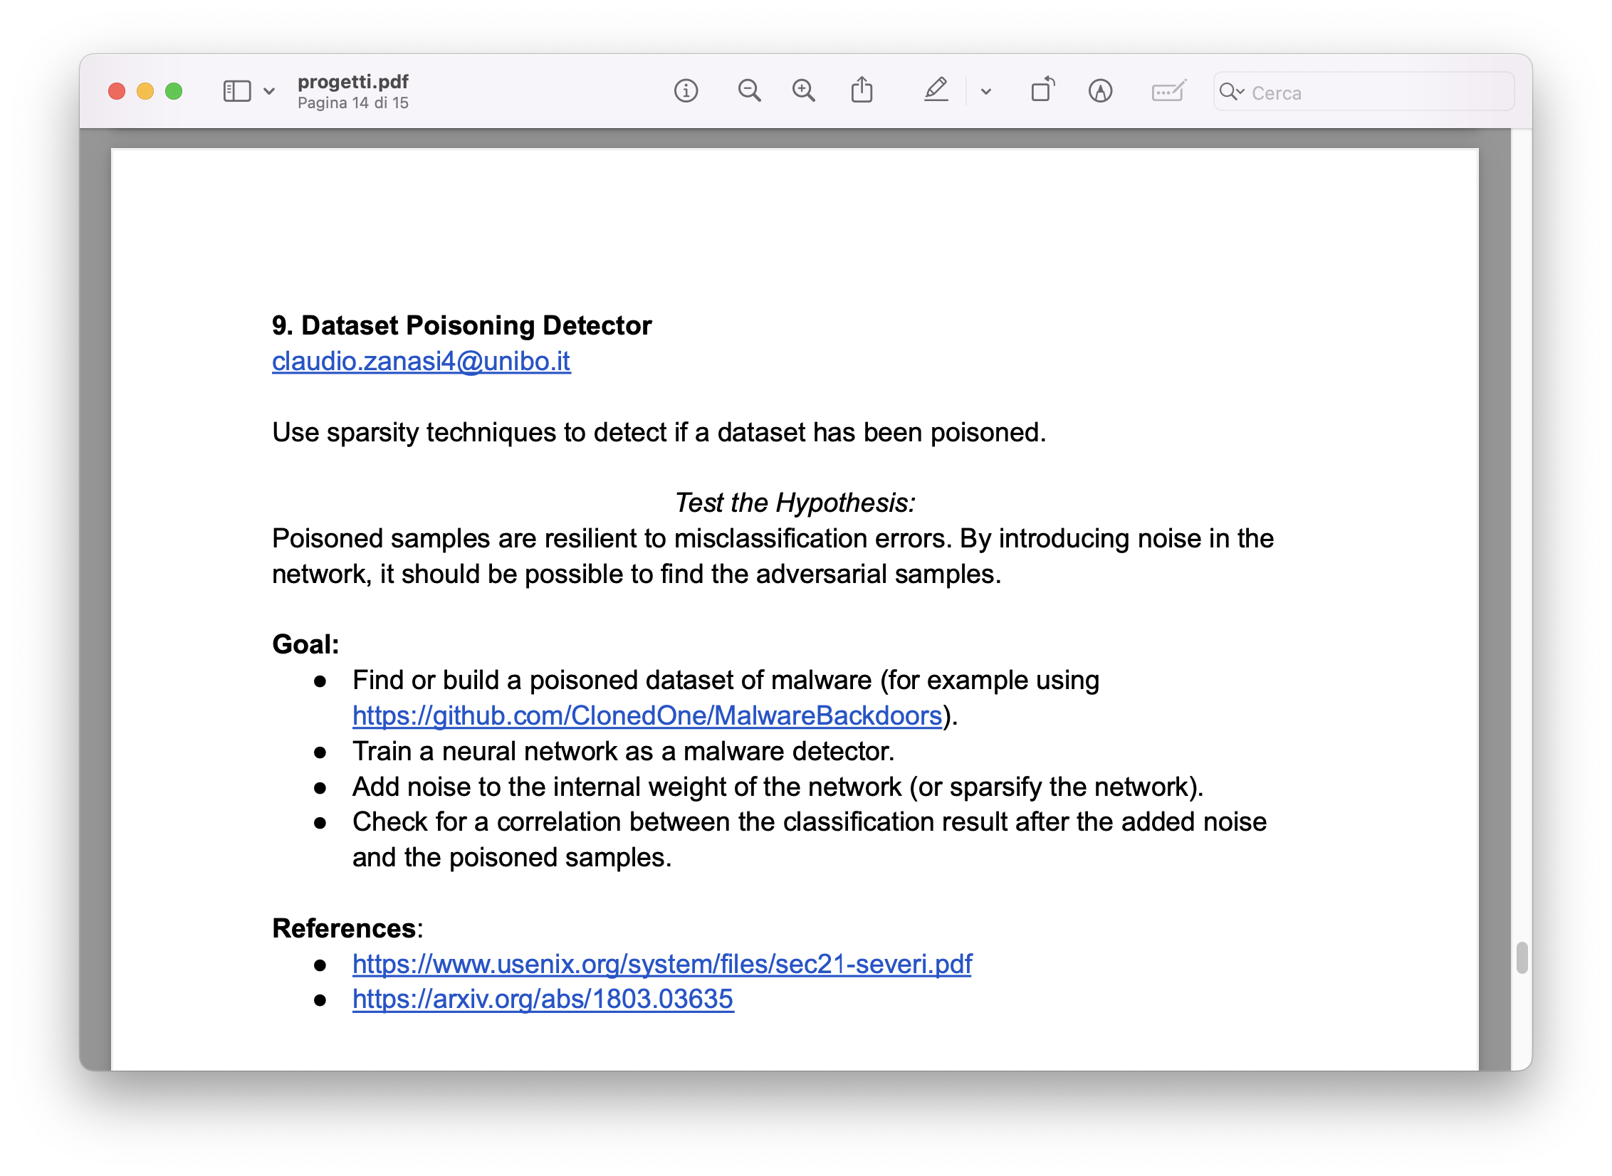
The intuition
The project aims to verify whether backdoored samples:
show resilience to misclassification when the model is perturbed
react differently than normal samples when noise or pruning is applied.
Why?

Slide 4
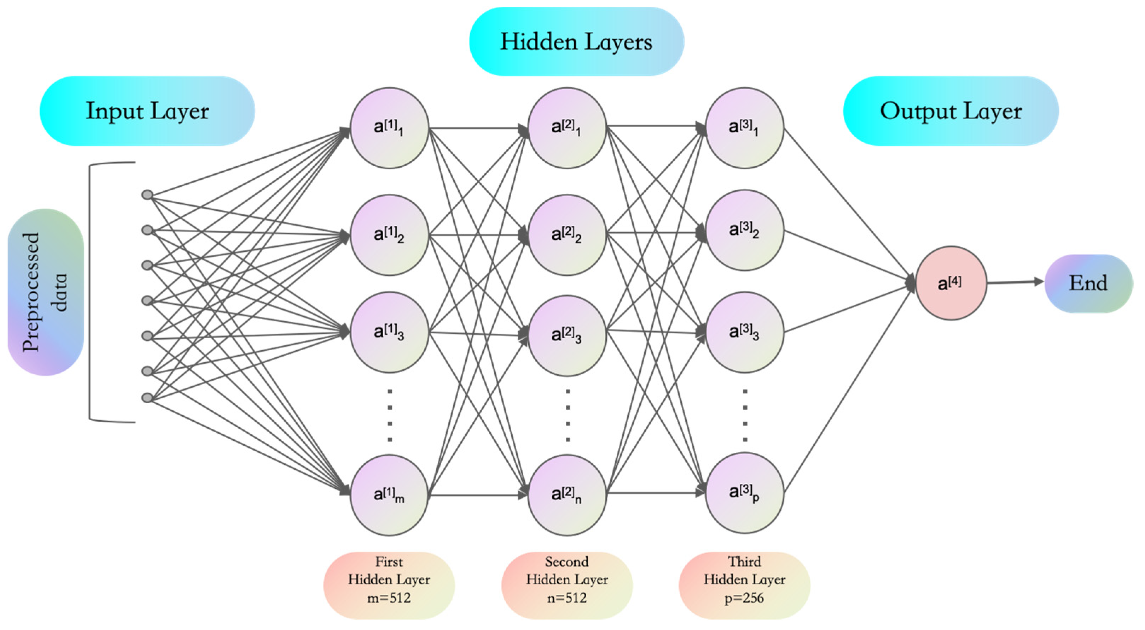

THE LOTTERY TICKET HYPOTHESIS: FINDING SPARSE, TRAINABLE NEURAL NETWORKS
Subnetworks contain “optimal” value (winning tickets)
These subnetworks have values very similar to those of the same network at the end of training.
These subnetworks are robust to noise and perturbations
Have better results in less training time

Slide 5

Adversarials' attacks
EVASION
POISONING
Manipulation in inference
Manipulation in training

Slide 6
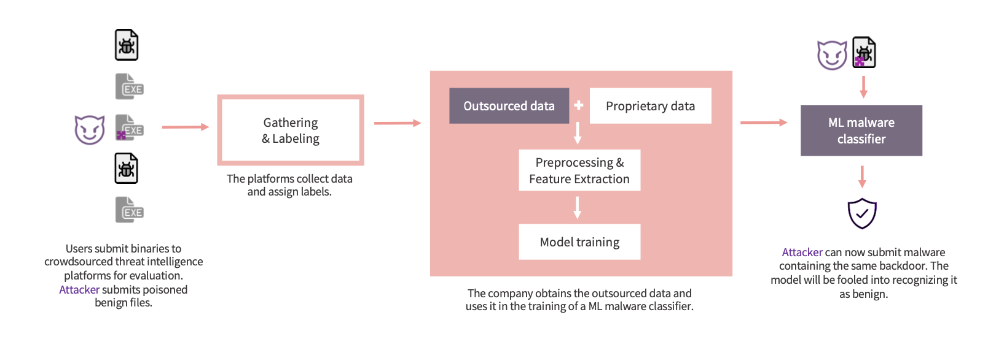
Why is poisoning a real problem?

Slide 7


Backdoor poisoning
The attacker inserts a trigger pattern in the features.
The model learns to associate it with the class chosen by the attacker.
In testing, simply reinsert the trigger that causes the misclassification.

Slide 8


Why is it so difficult to defend from?
Camouflage | The trigger blends in with the real features.
Confusion | Poisoned samples end up in high-density areas and confuse clustering/analysis.
Absence of abnormalities | There is no label manipulation.

Slide 9
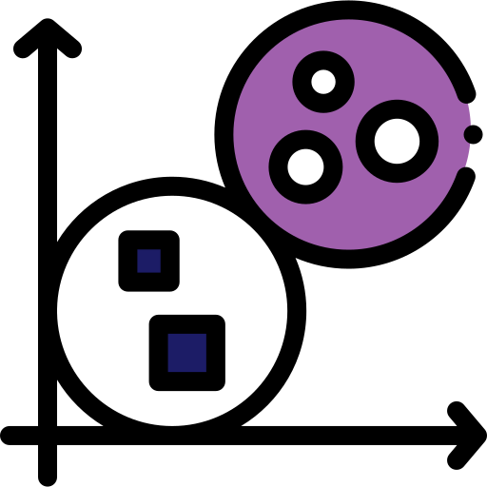
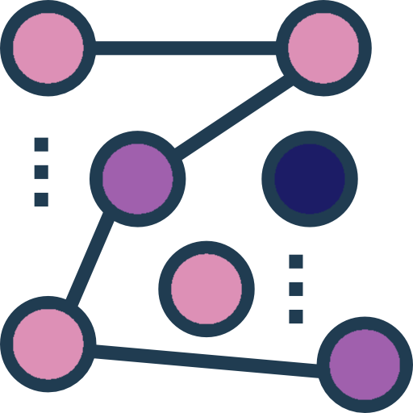

Types of defenses (Severi et al.)
HDBSCAN
Forms dense clusters and marks sparse points as outliers.
Spectral signatures
Isolation Forest
Search for separable subpopulations. Only works if the trigger creates an isolated cluster.
Isolate anomalies by building random trees that quickly separate rare points from normal ones.

Slide 10
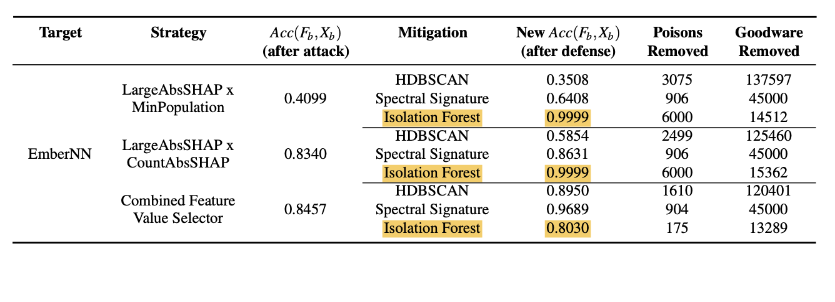
Types of defenses (Severi et al.)
Isolation Forest
HDBSCAN
Density-based hierarchical clustering: forms dense clusters and marks sparse points as outliers.
Isolate anomalies by building random trees that quickly separate rare points from normal ones.
Spectral signatures
Search for separable subpopulations in SVD. Only works if the trigger creates an isolated cluster.

Slide 11
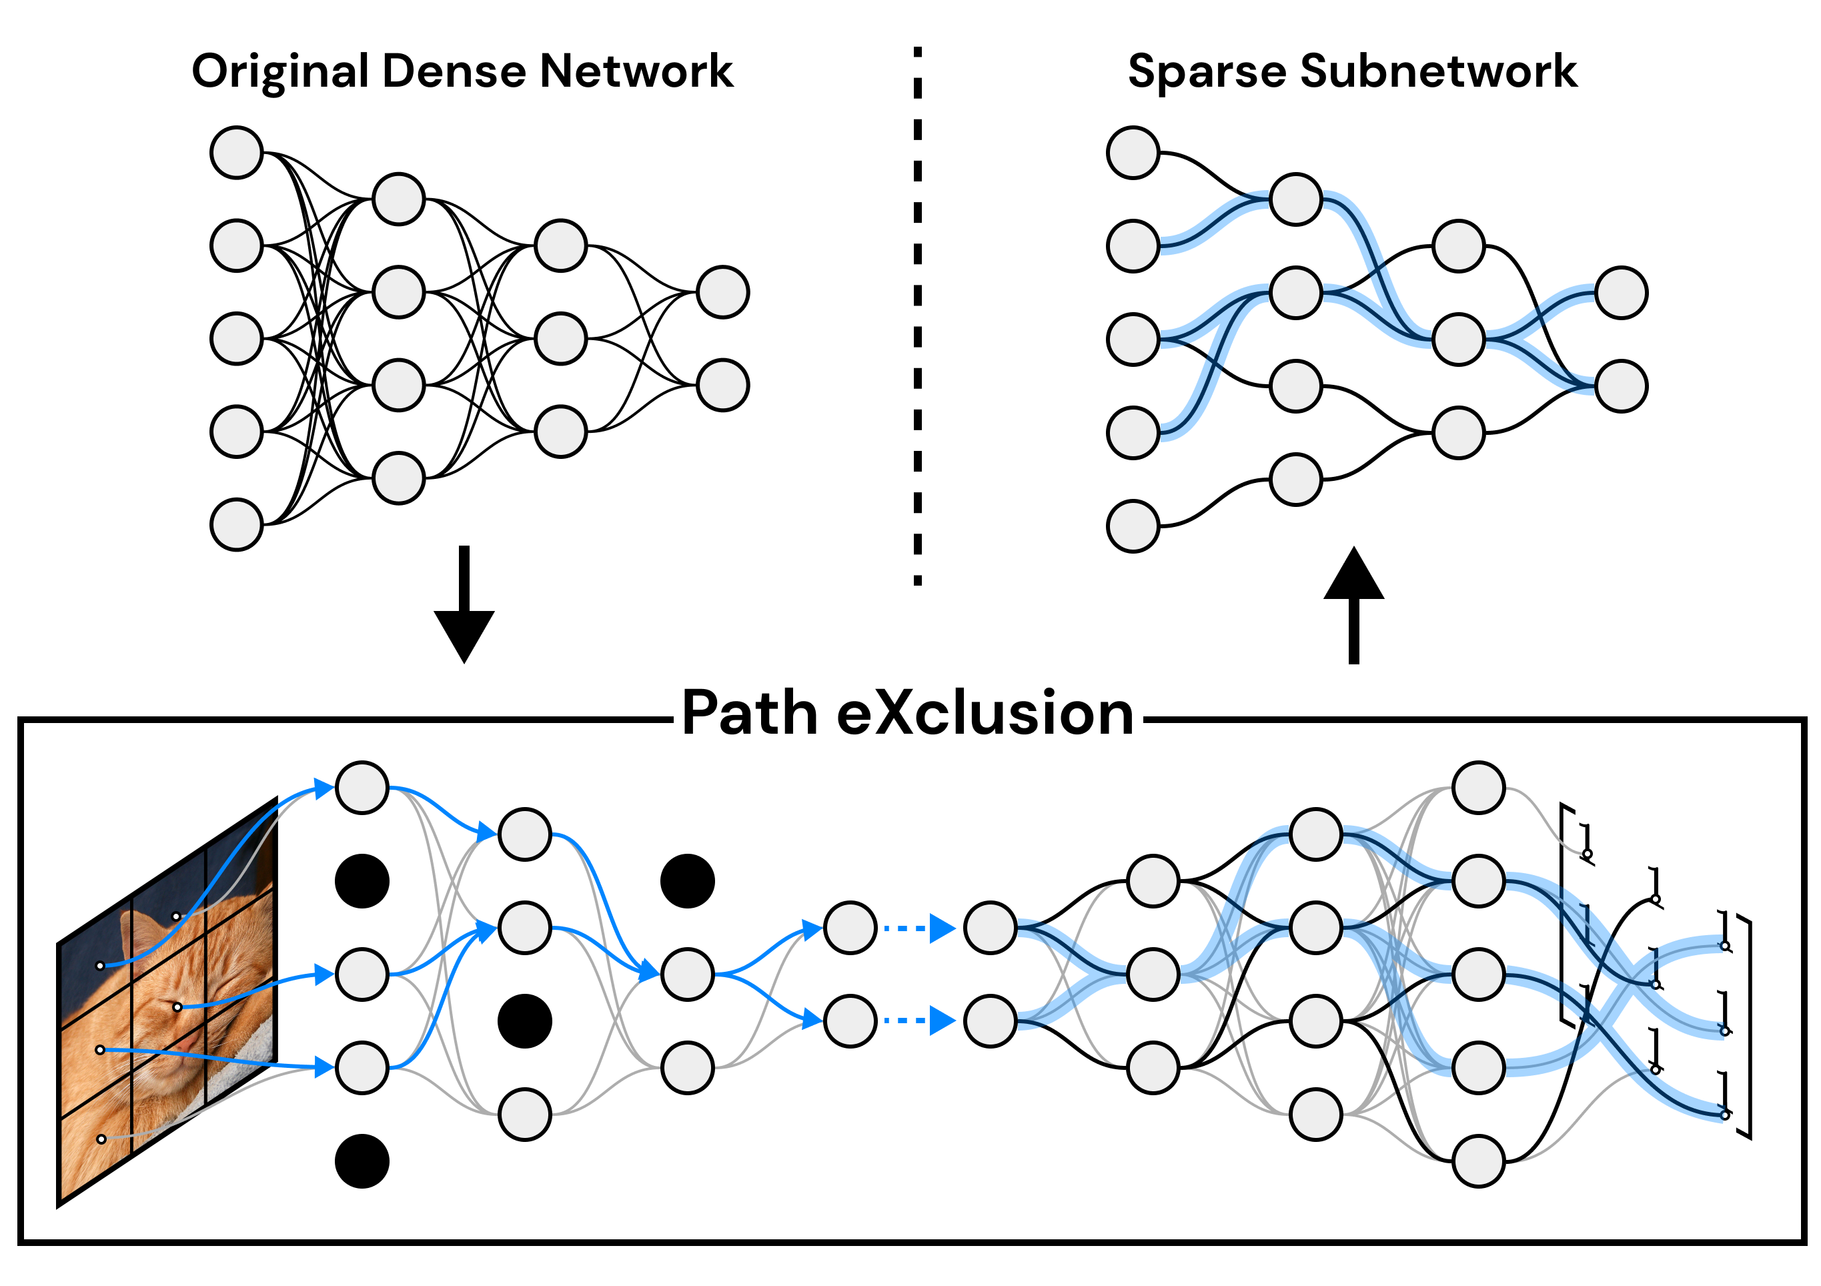
Sparsity as a possible defense
Eliminate unnecessary weight. Triggers may be less effective.
However, as LTH suggests, the backdoor could be so well reinforced during training that it behaves like an optimal subnetwork, so it resists even if you remove weights.

Slide 12
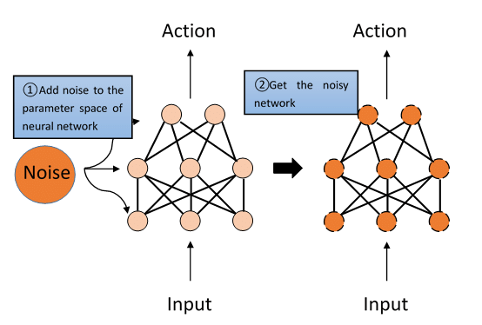
Noise as a possible defense
Adding controlled noise to a neural network's weights to detect backdoors
The asymmetry between clean and poisoned predictions serves as a detection signal

Slide 13

Objective
 | Create/find a Dataset
 | Training a NN on clean dataset
 | Poison Dataset and re train the NN
 | Evaluate different method to recovery the loss

Slide 14







Ember dataset and Preprocessing
SIZE
EXTRACTION
1.1 million PE samples.
Features extracted with the library
FEATURES
NORMALIZATON
2381 numerical features
Complete normalization
ember
SAMPLING
PHILTERING
Subset selected for computational reasons.
Feature removal: • high correlation • zero variance • redundancy

Slide 15
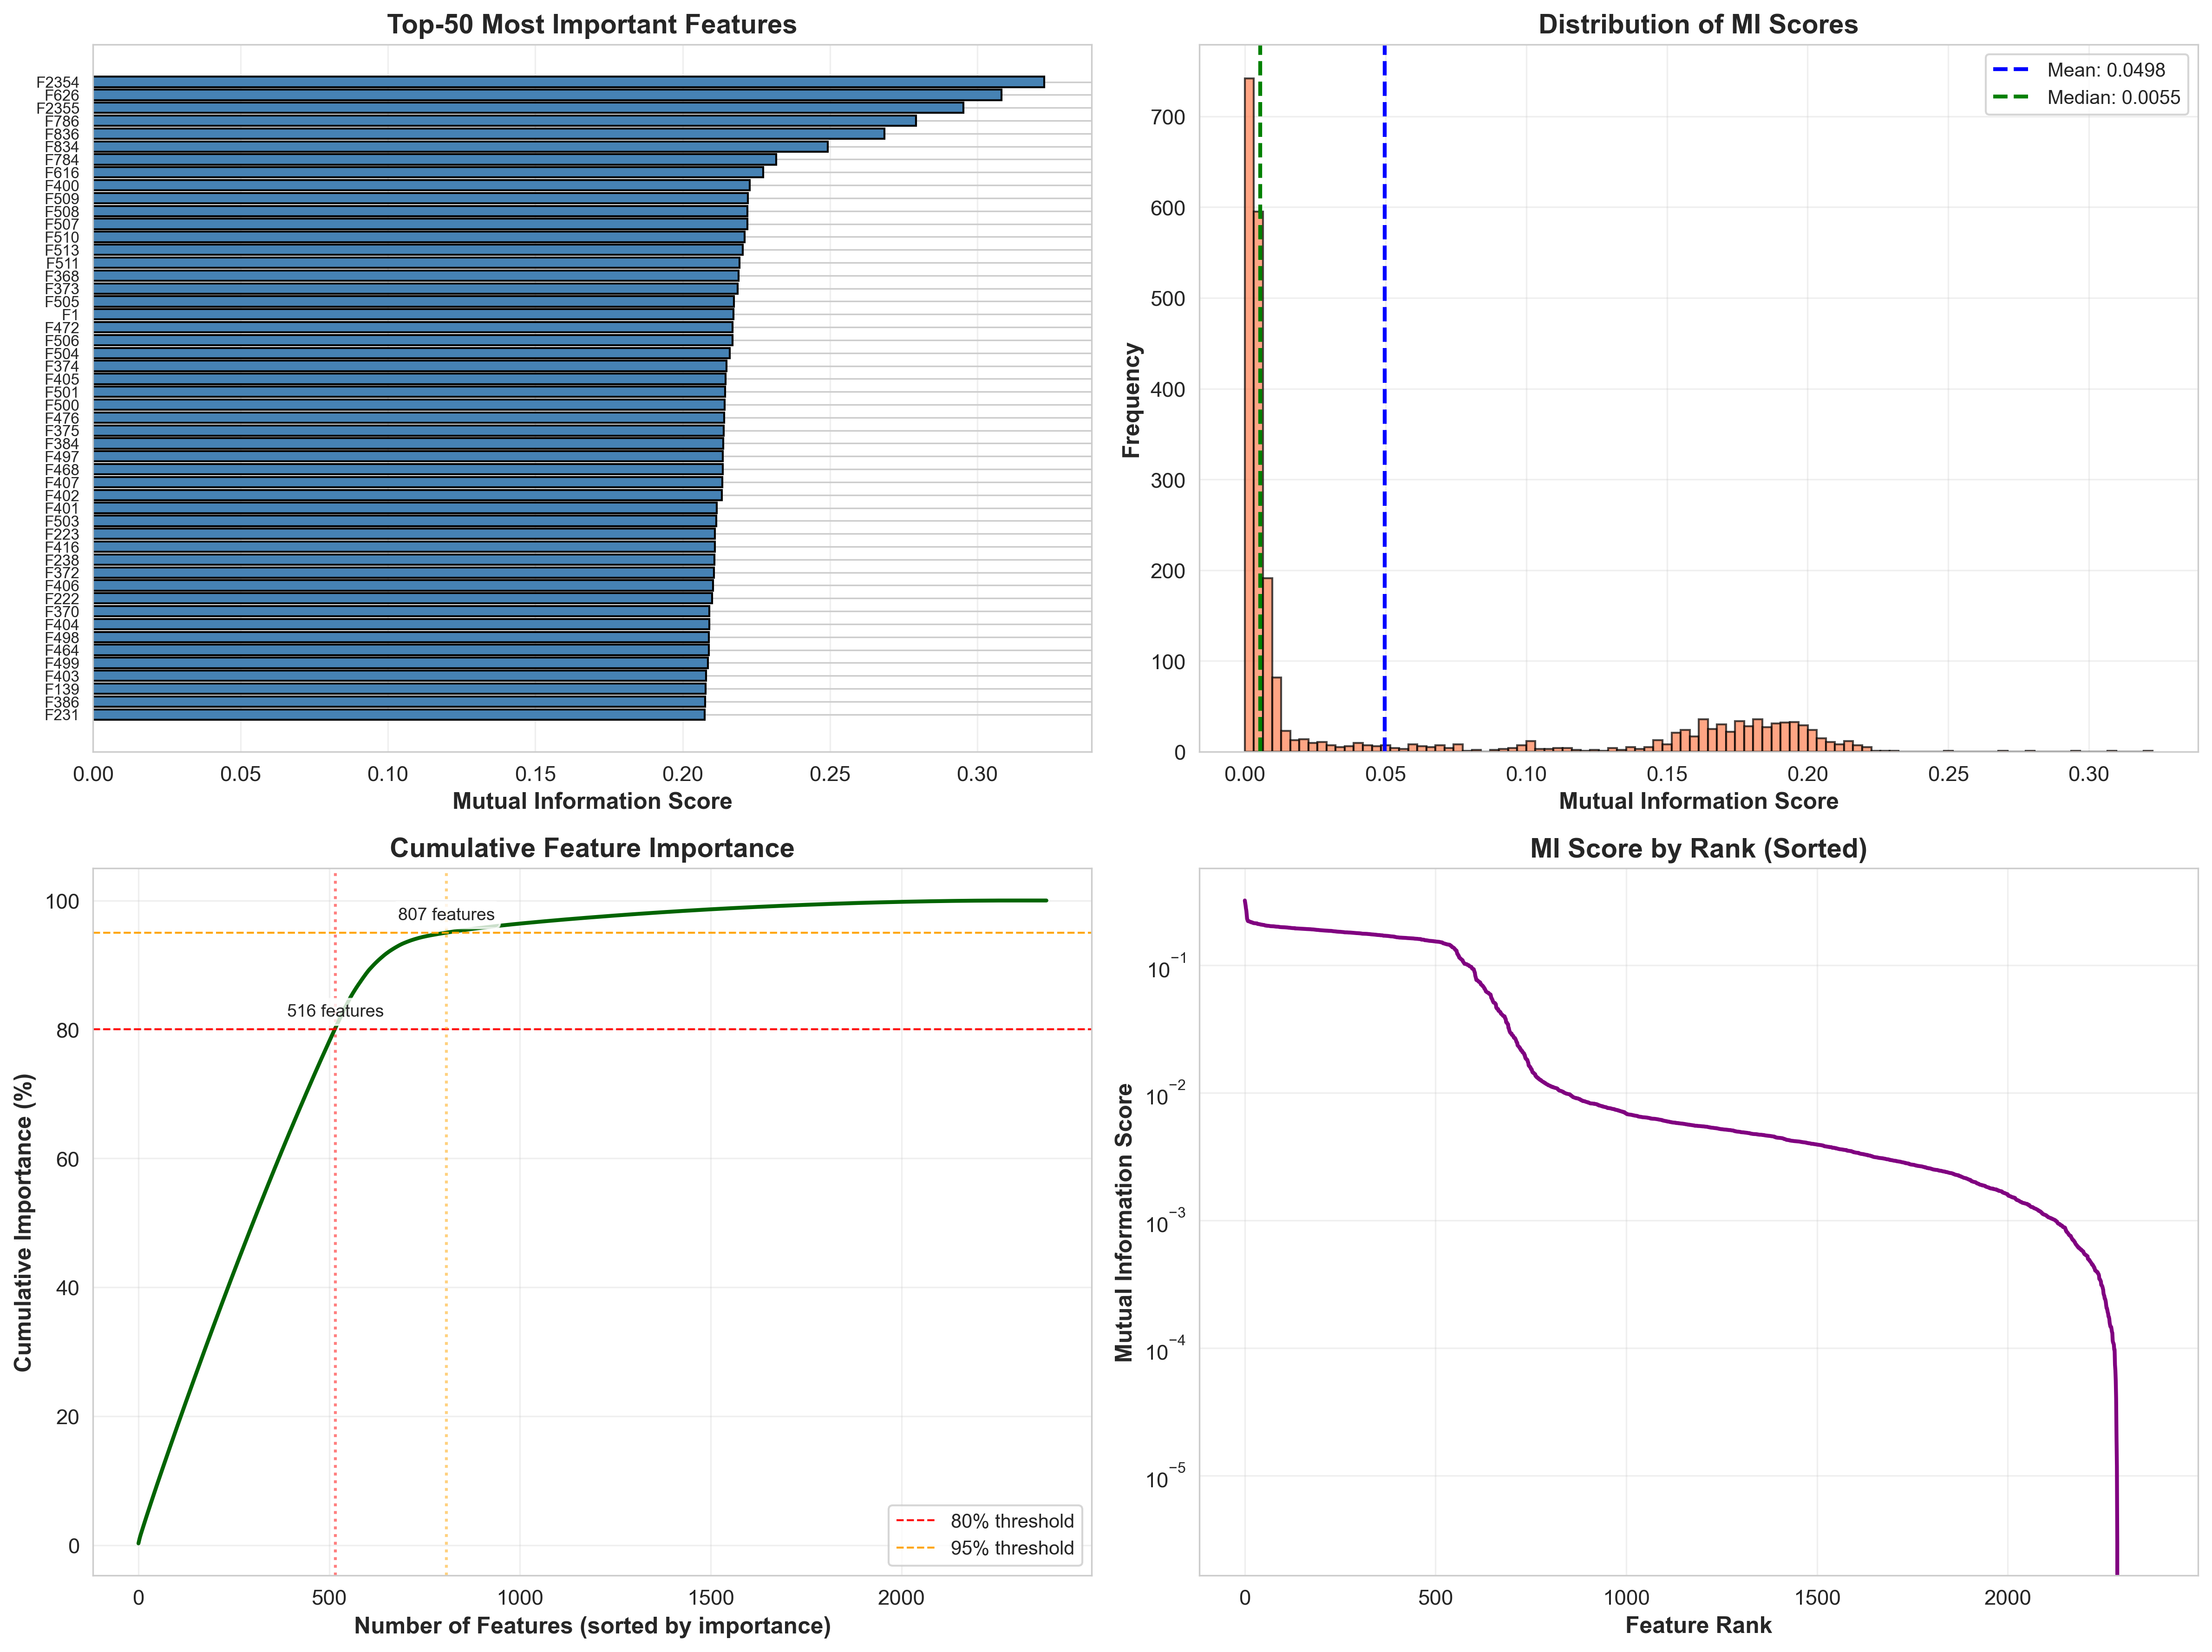
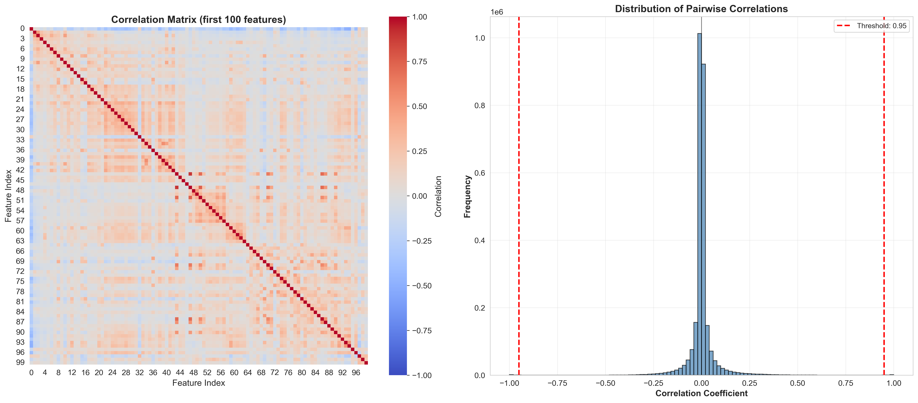
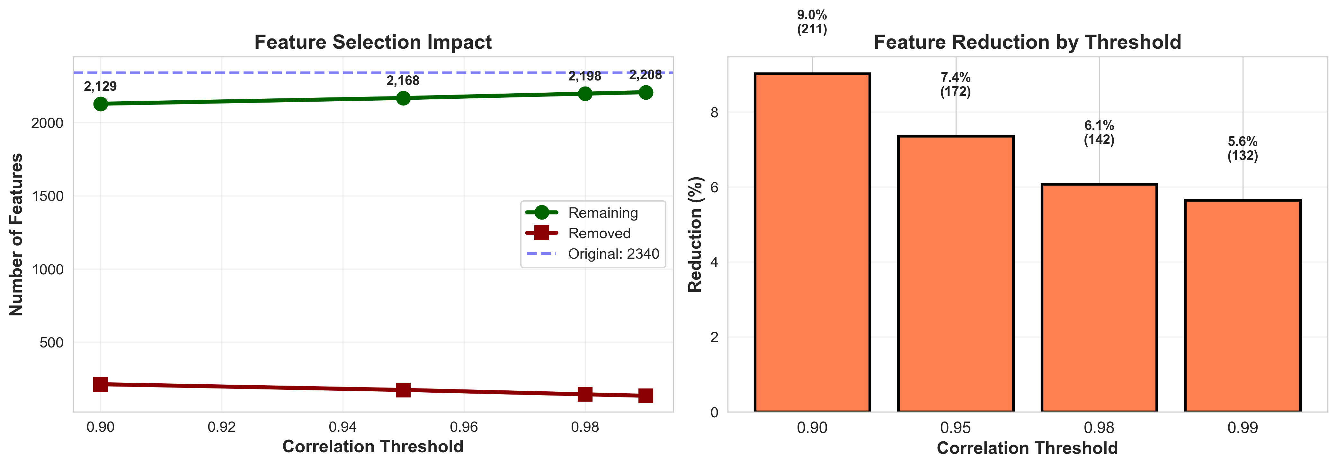
Ember additional Info

Slide 16






Limitations
DATA
HARDWARE LIMITATION
TESTING
Contagio
Attacks tested only with 1%, 3% poisoning.
Not tested for:
0.25%,0.5%, 1.5%,
2%, 4%
MAC
Not specified witch subset was used in the paper's test
M1, 16GB
Difficulty to replicate all the results metrics in the paper
Debrin
LENOVO
Available previous authorization
Ryzen 4700U, 16GB

Slide 17

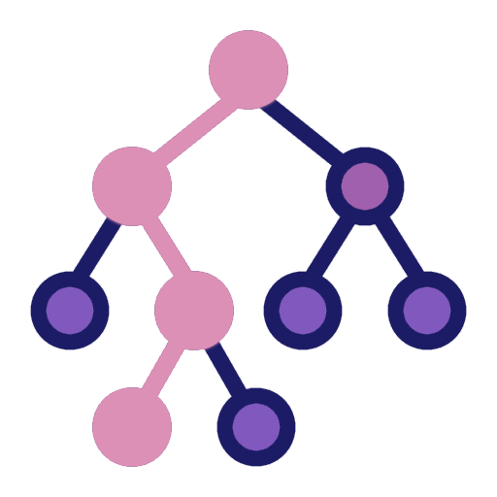




Test pipeline
POISON
PRUNING
Model training on poisoned datasets
Progressive pruning 0–90%
OUTCOME
Graphs and tables are generated to evaluate the effectiveness of the test.
TRAIN
NOISE
ISOLATION FOREST
Clean model training
Noise injection on weights
Detect anomalies in benign samples and remove outliers

Slide 18
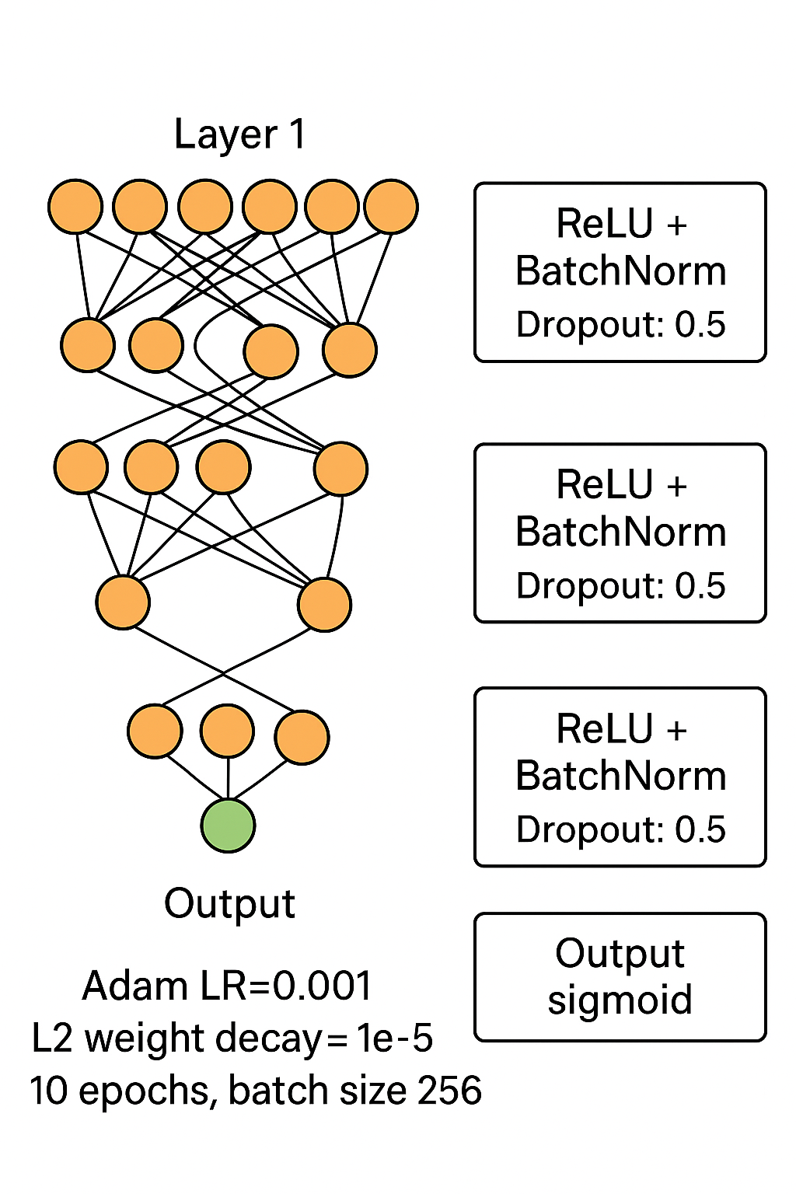
Model architecture
Rete fully-connected:
Layer 1: 4000 neurons
Layer 2: 2000 neurons
Layer 3: 100 neurons
Output sigmoid ReLU +
BatchNorm per each layer. Dropout: 0.5 Adam LR=0.001 L2 weight decay = 1e−5 10 epoche, batch size 256.
TRAIN
Clean model training

Slide 19
Test pipeline
POISON
PRUNING
Model training on poisoned datasets
Progressive pruning 0–90%
OUTCOME
Graphs and tables are generated to evaluate the effectiveness of the test.
TRAIN
NOISE
ISOLATION FOREST
Clean model training
Noise injection on weights
Detect anomalies in benign samples and remove outliers

Slide 20


Attack implemented
Clean-label backdoor on 1% and 3%
of benign instances
POISON
Model training on poisoned datasets
Modified 16/32/48/64/128 features
20
Total of experiments
TRAIN
Clean model training

Slide 21
Test environments
10
Mac Air 2020 – M1, 16GB RAM
POISON
Model training on poisoned datasets
20
10
University Cluster - rtx2080
Available from 1th December
TRAIN
Clean model training

Slide 22
Test pipeline
POISON
PRUNING
Model training on poisoned datasets
Progressive pruning 0–90%
OUTCOME
Graphs and tables are generated to evaluate the effectiveness of the test.
TRAIN
NOISE
ISOLATION FOREST
Clean model training
Noise injection on weights
Detect anomalies in benign samples and remove outliers

Slide 23

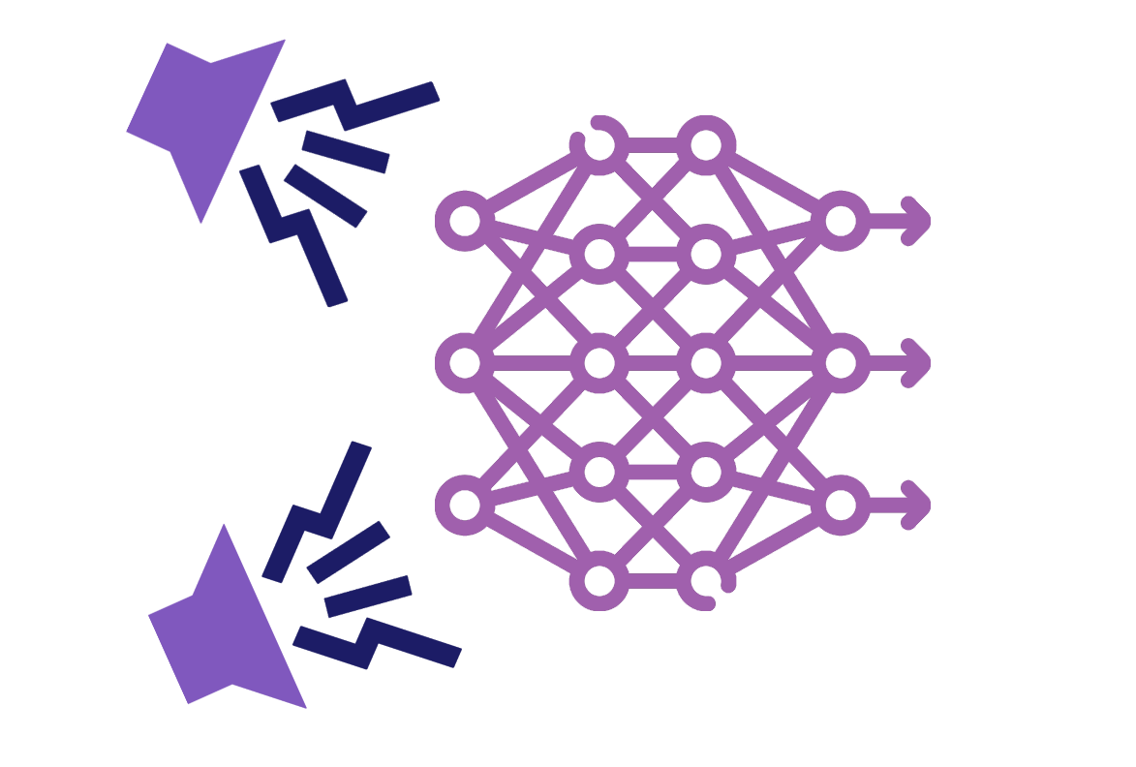


Gaussian noise and selection criteria
POISON
01
02
03
Model training on poisoned datasets
Noise tested: from σ = 0.0001 to σ = 0.01
Noise added only to weights, not to biases
Automatic selection of the “optimal” noise level
NOISE
accuracy ≥ 50% and maximum difference between the prediction of the poisoned and disturbed model
Noise injection on weights
04

Slide 24
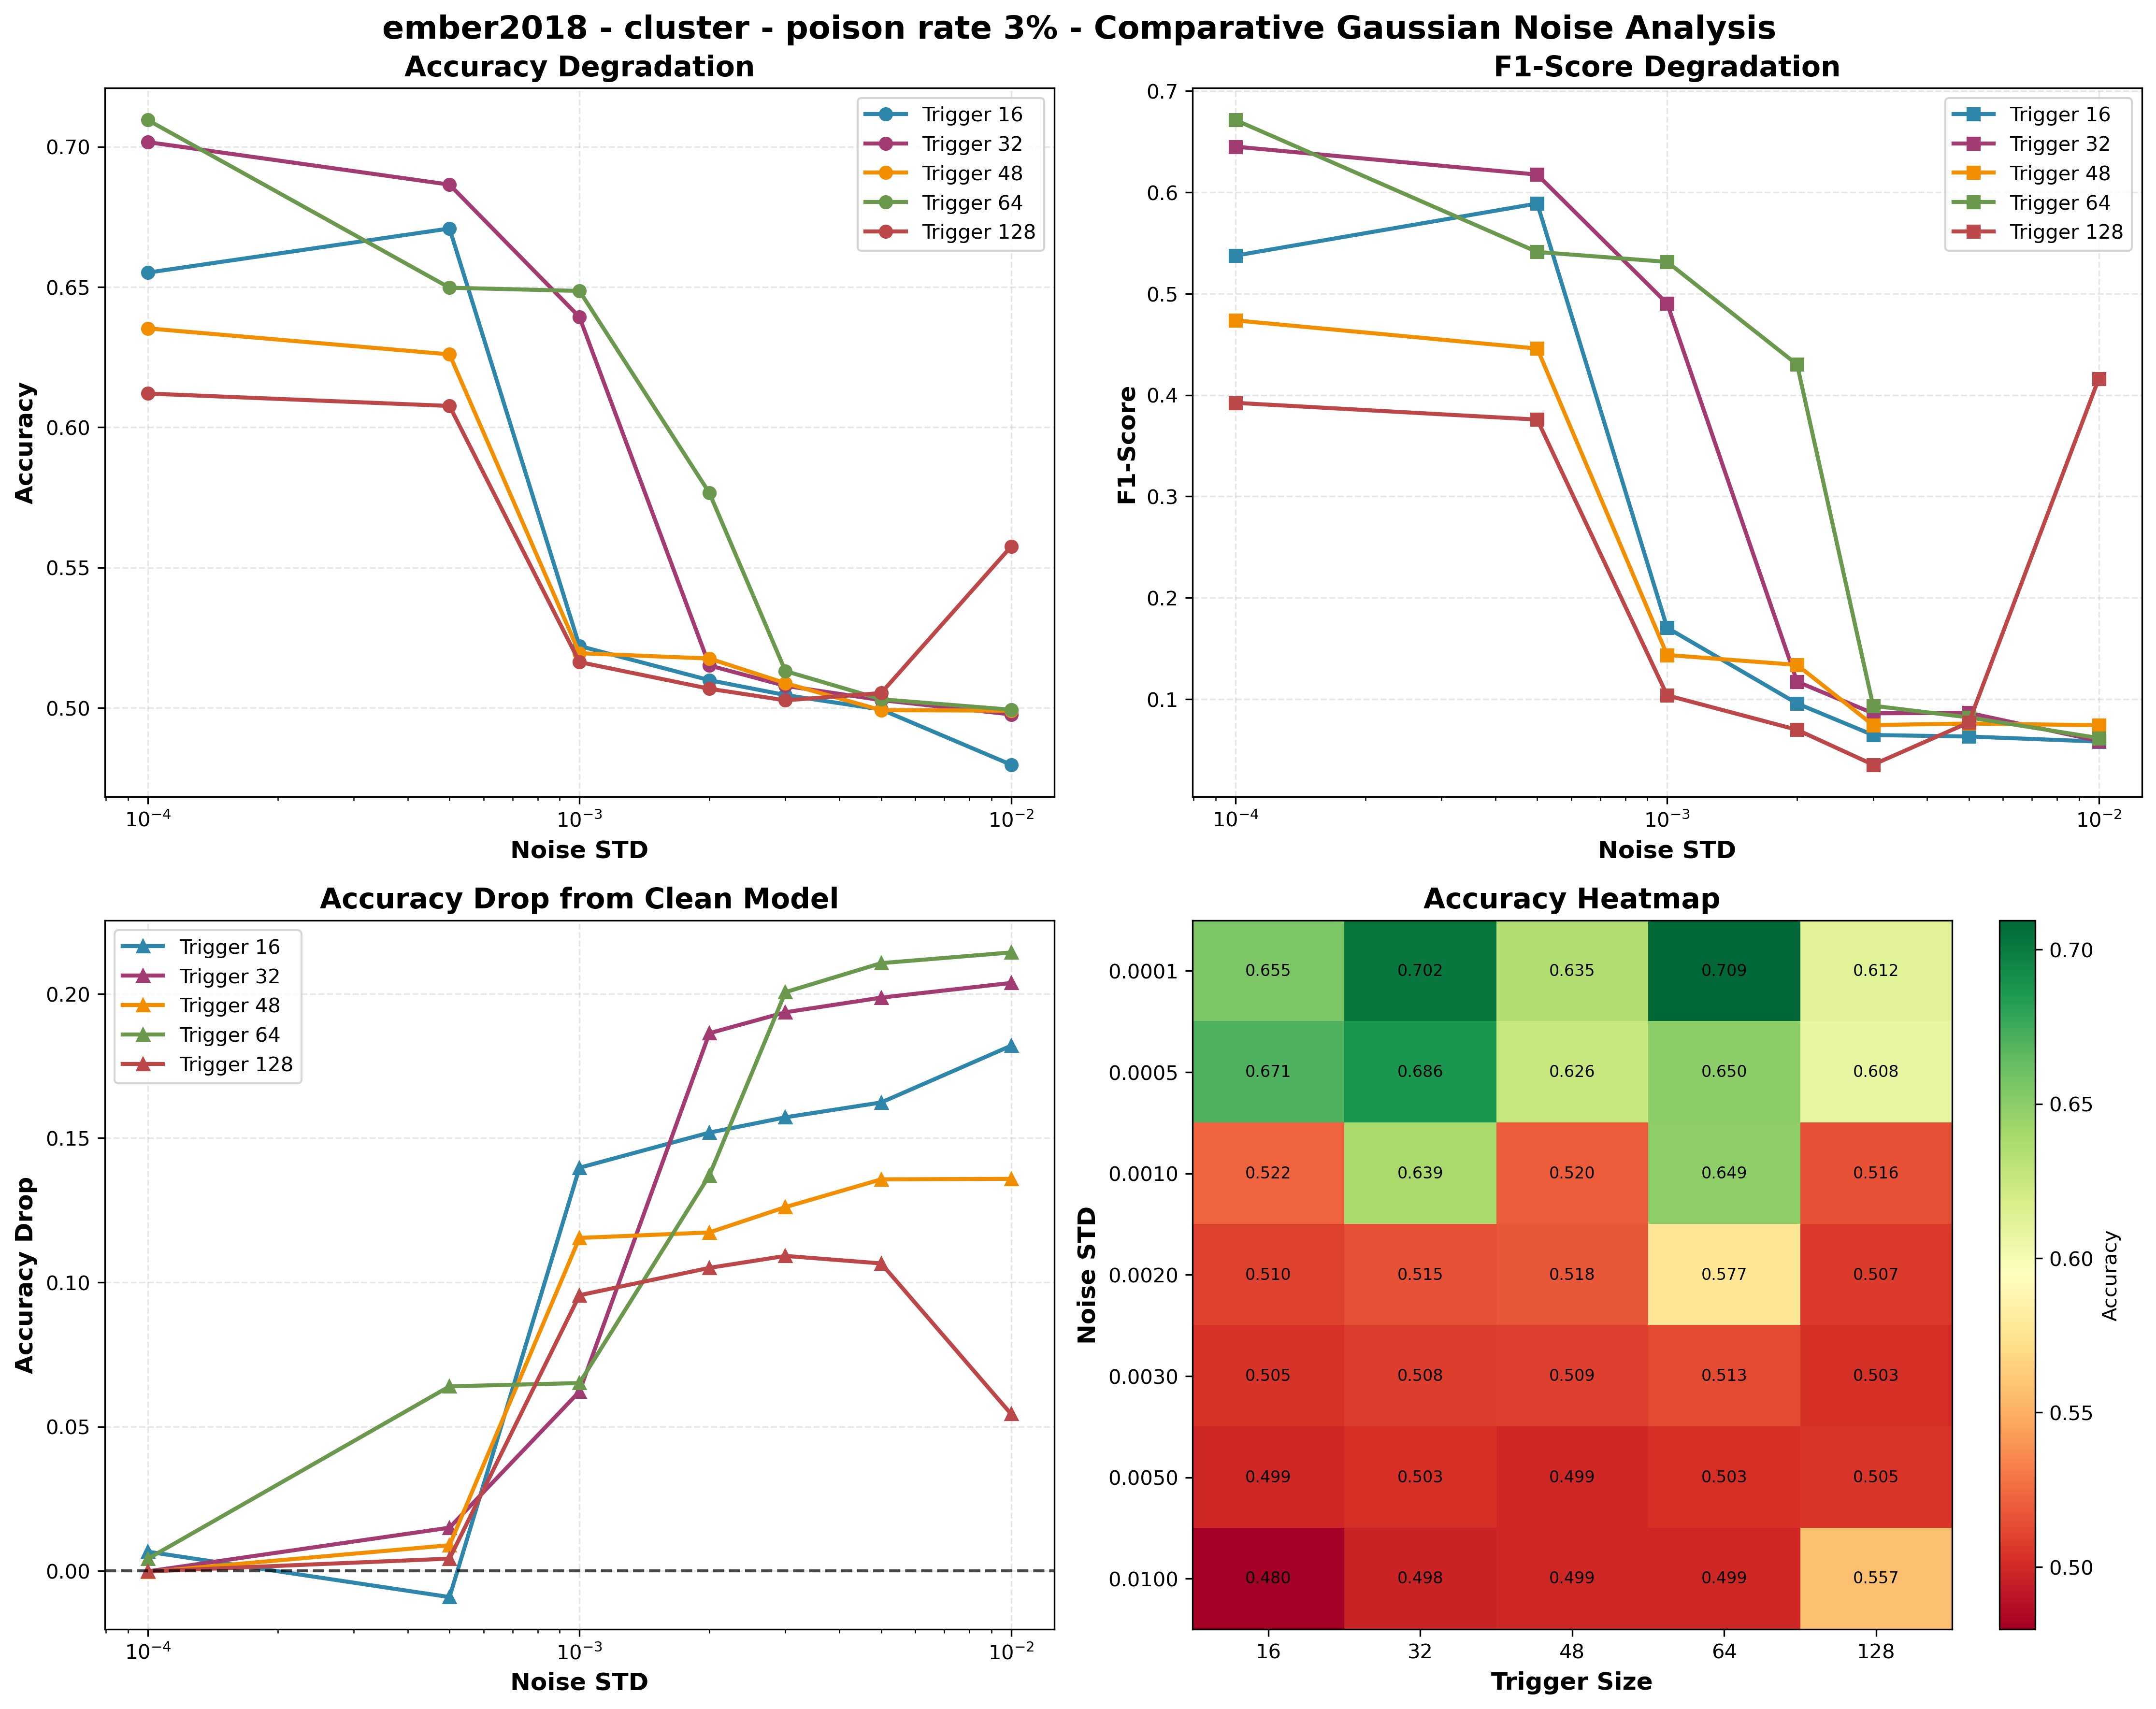
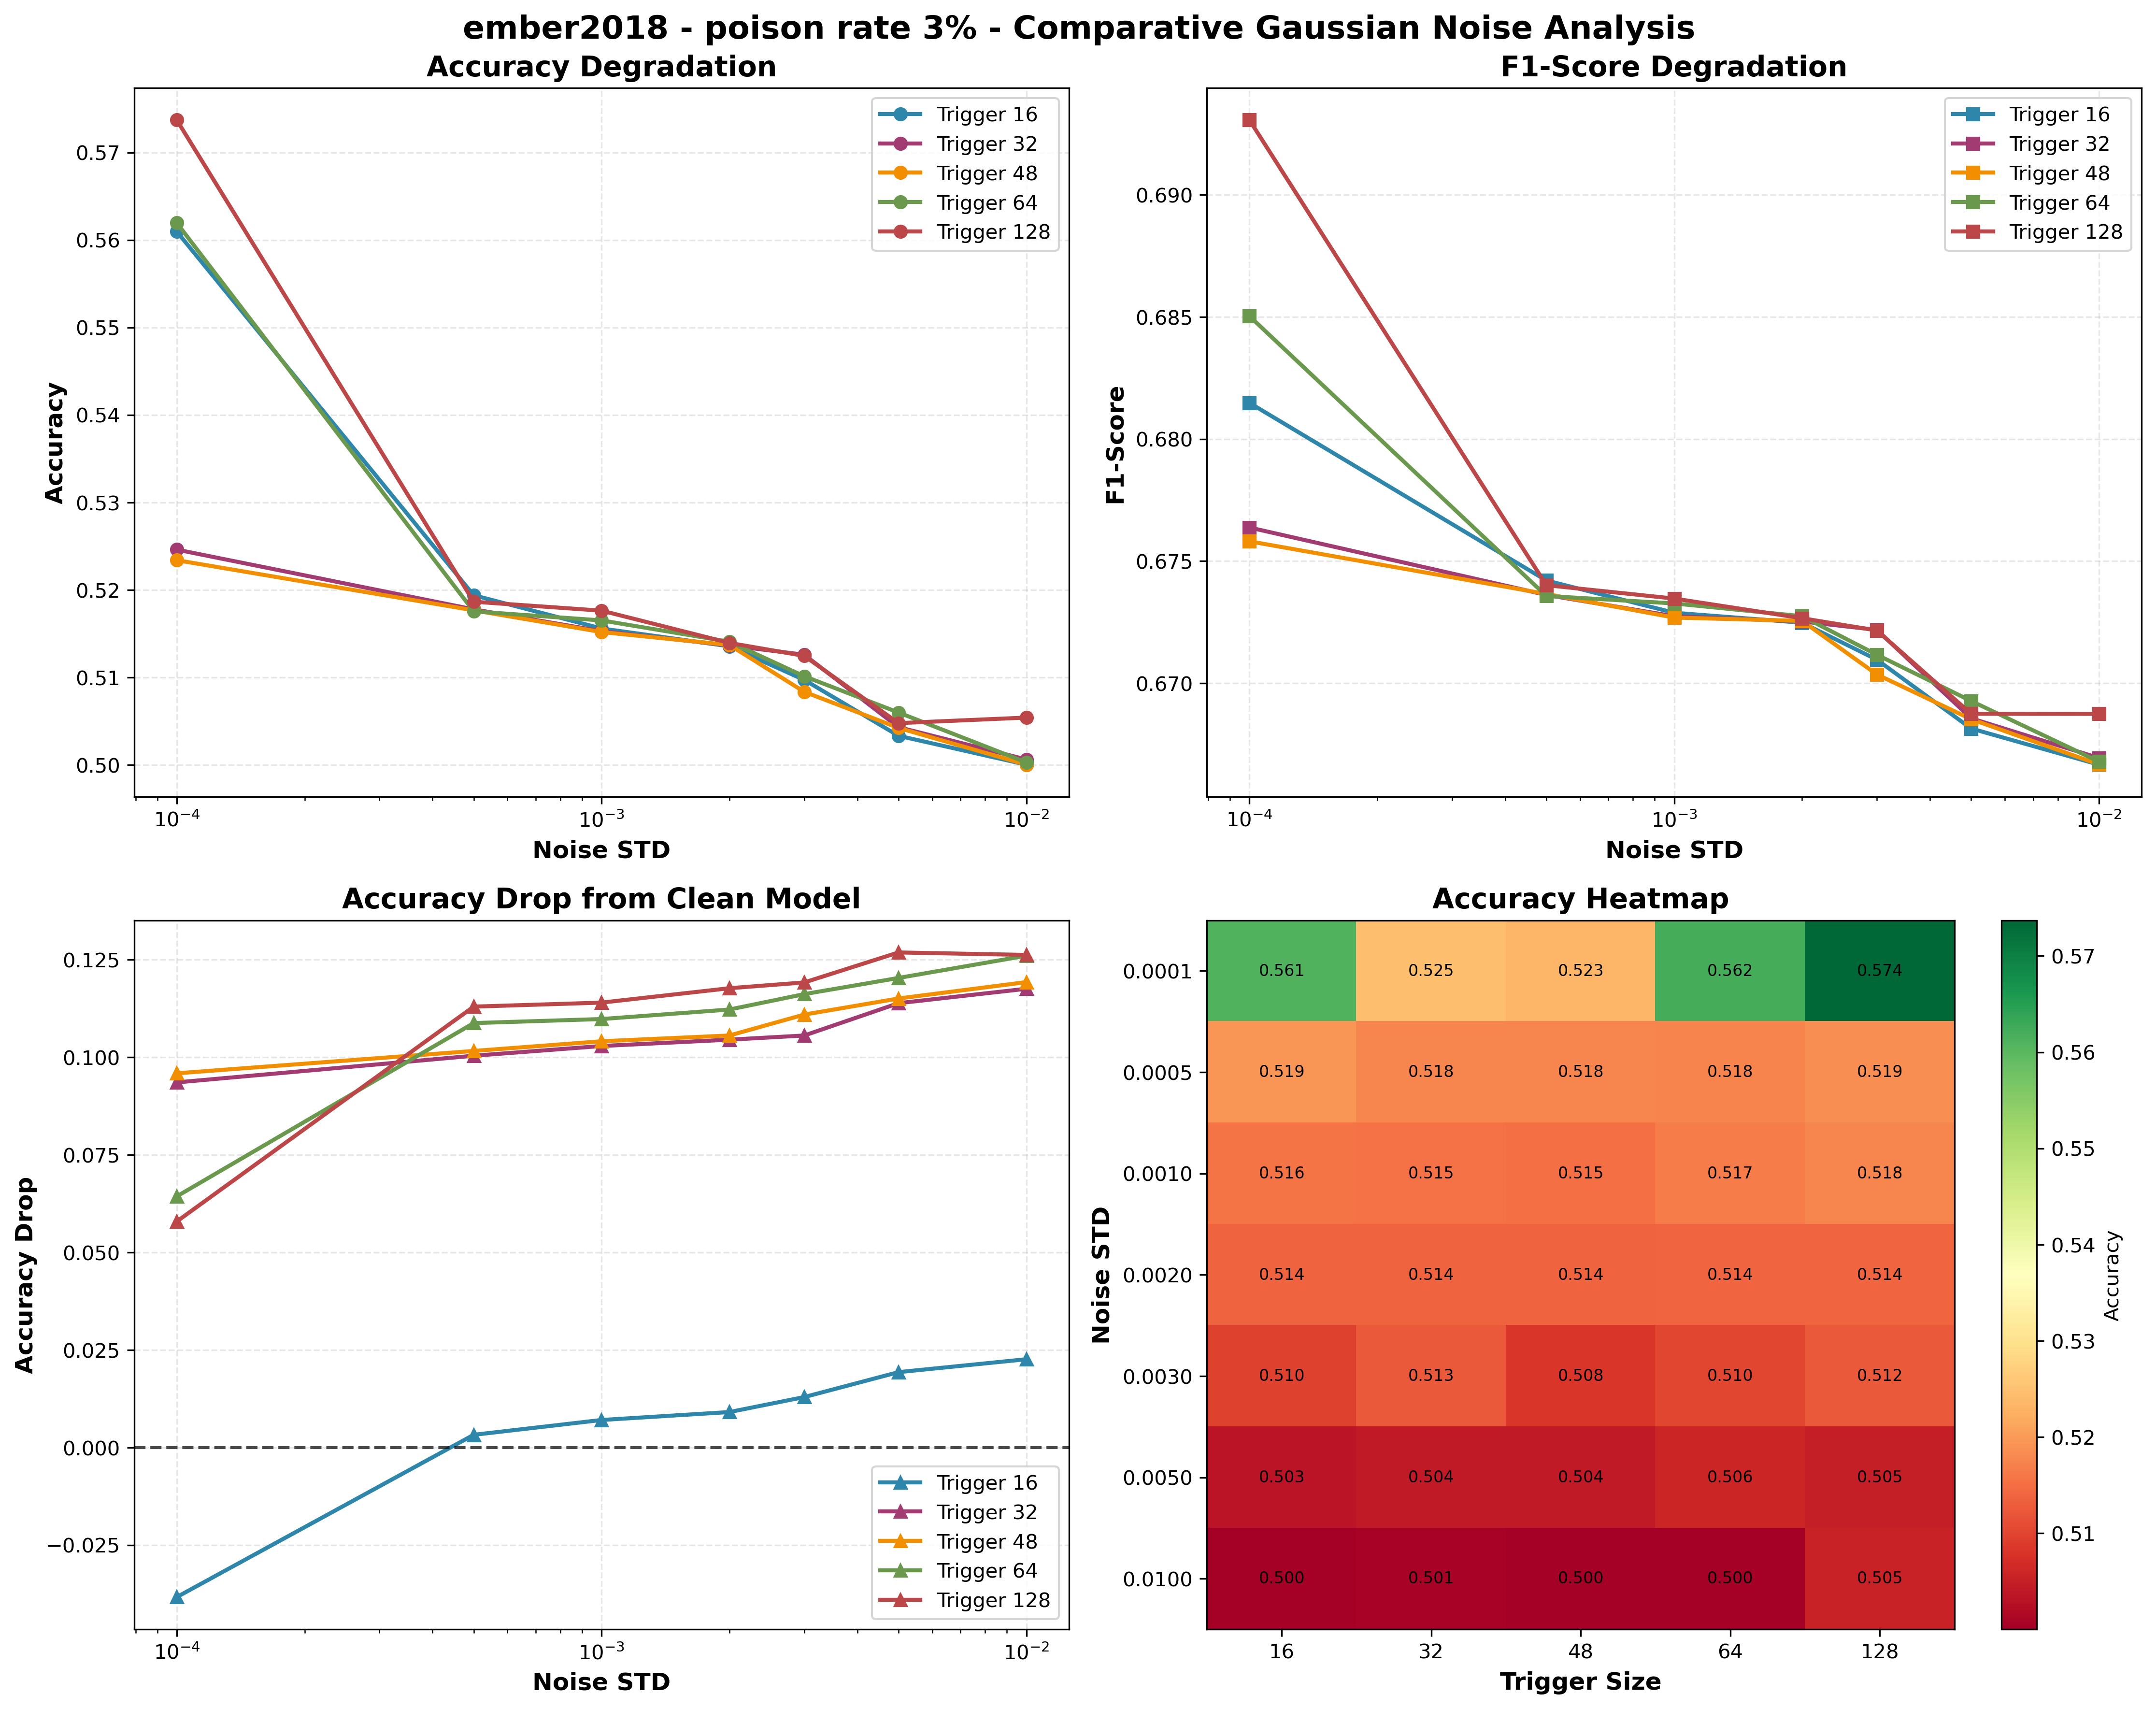
Gaussian noise analisys

Slide 25
Test pipeline
POISON
PRUNING
Model training on poisoned datasets
Progressive pruning 0–90%
OUTCOME
Graphs and tables are generated to evaluate the effectiveness of the test.
TRAIN
NOISE
ISOLATION FOREST
Clean model training
Noise injection on weights
Detect anomalies in benign samples and remove outliers

Slide 26
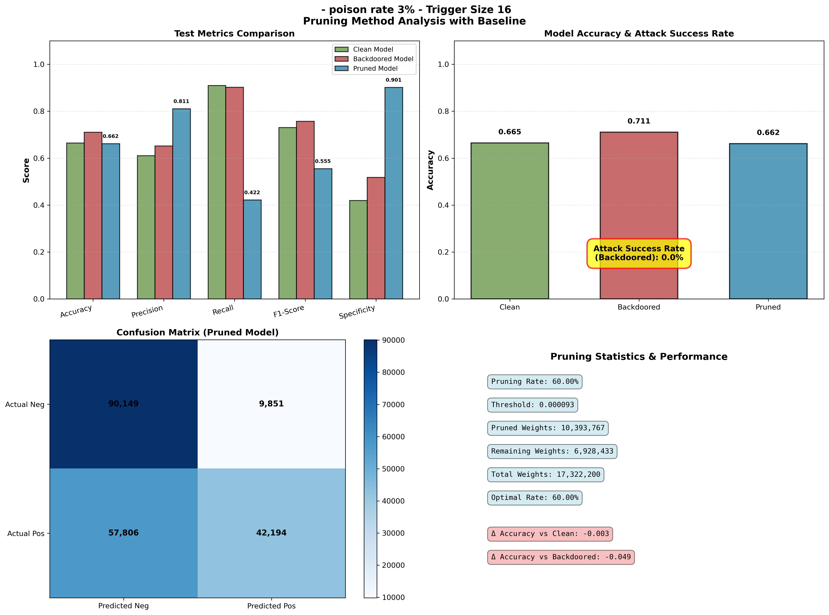
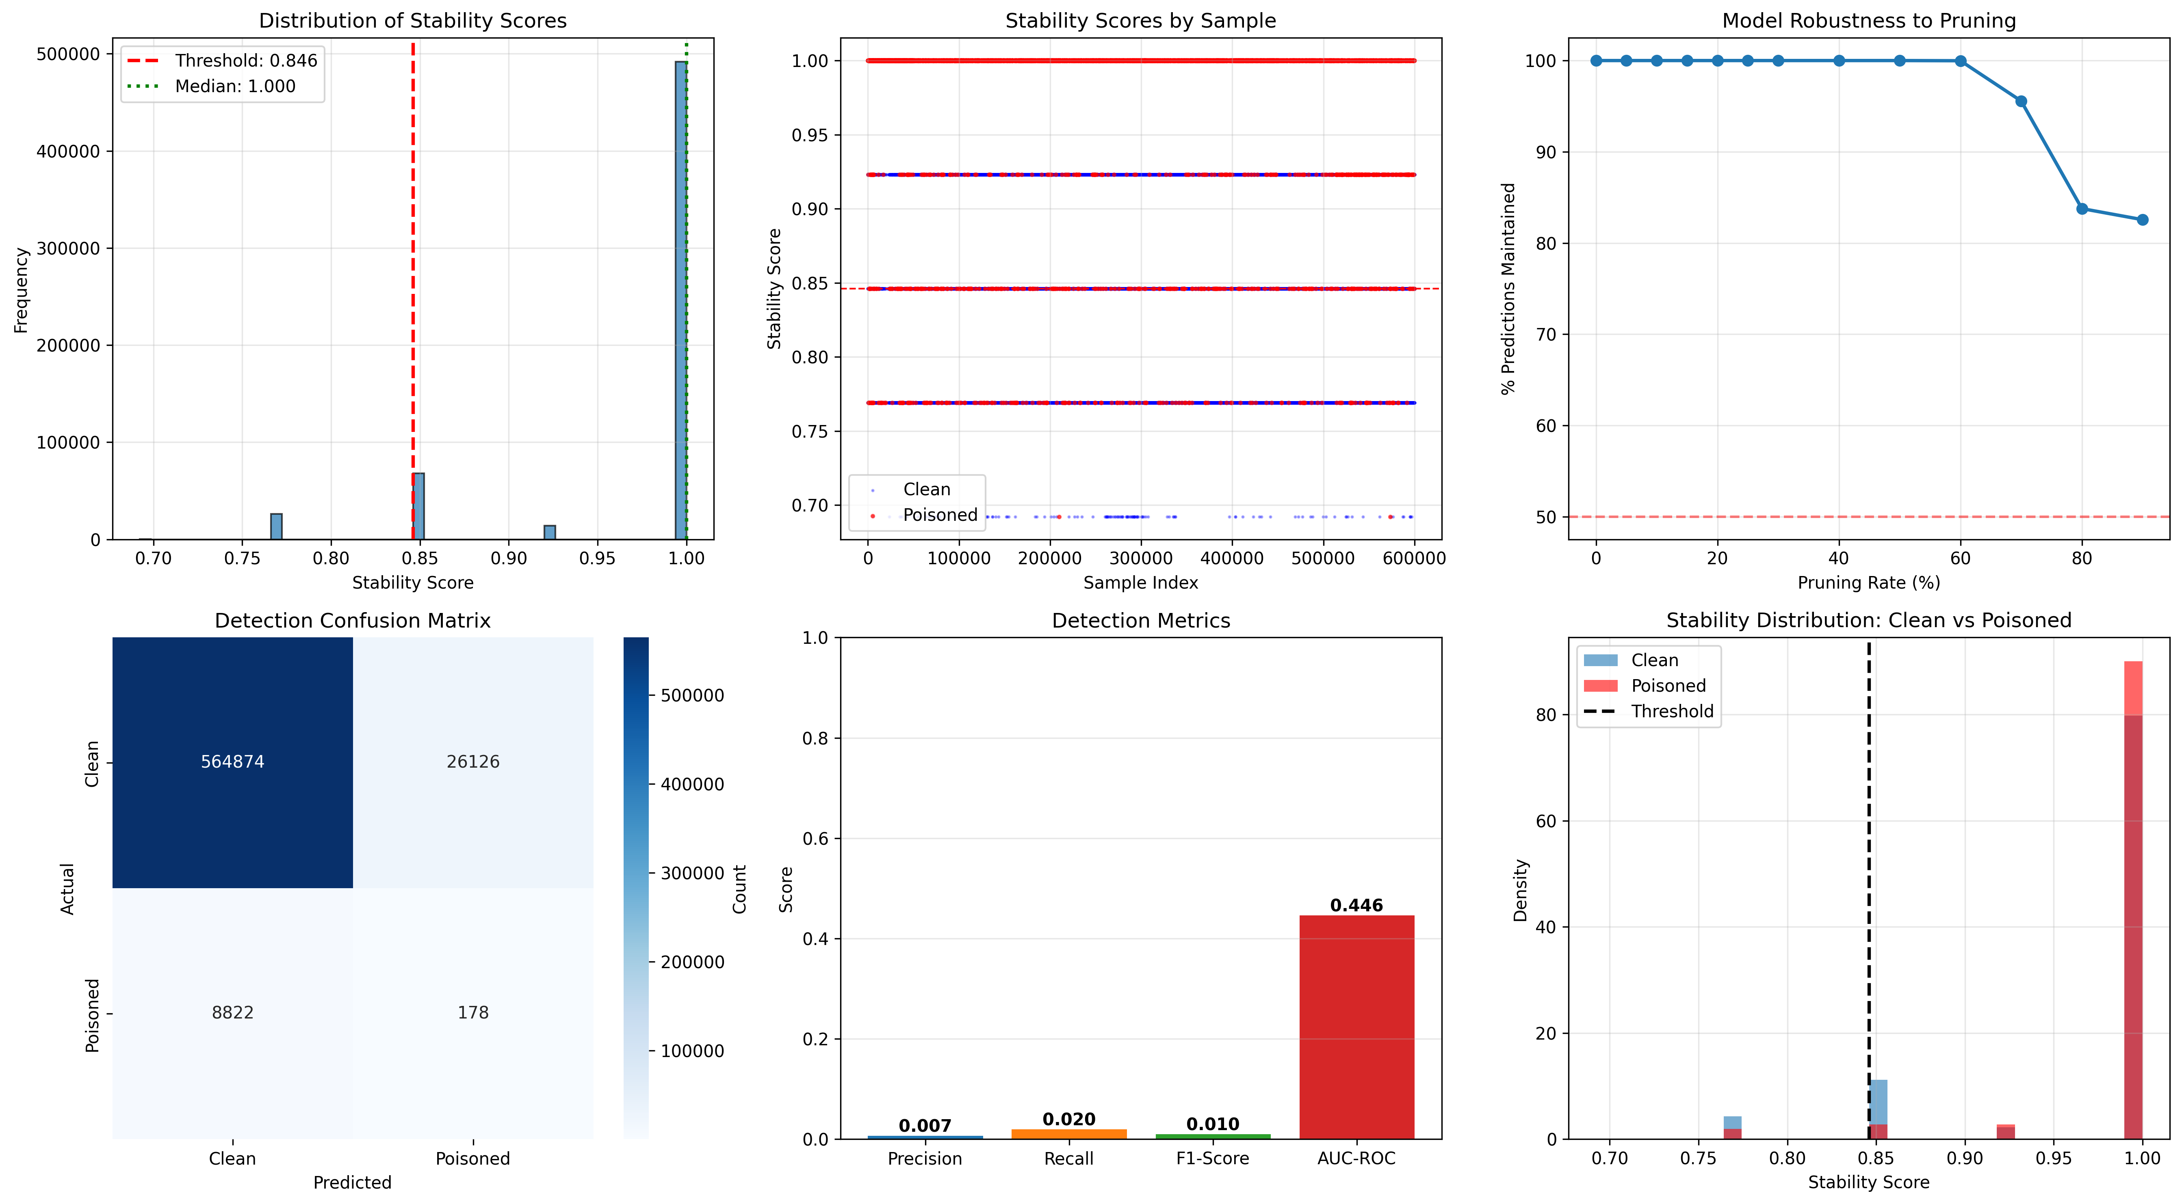
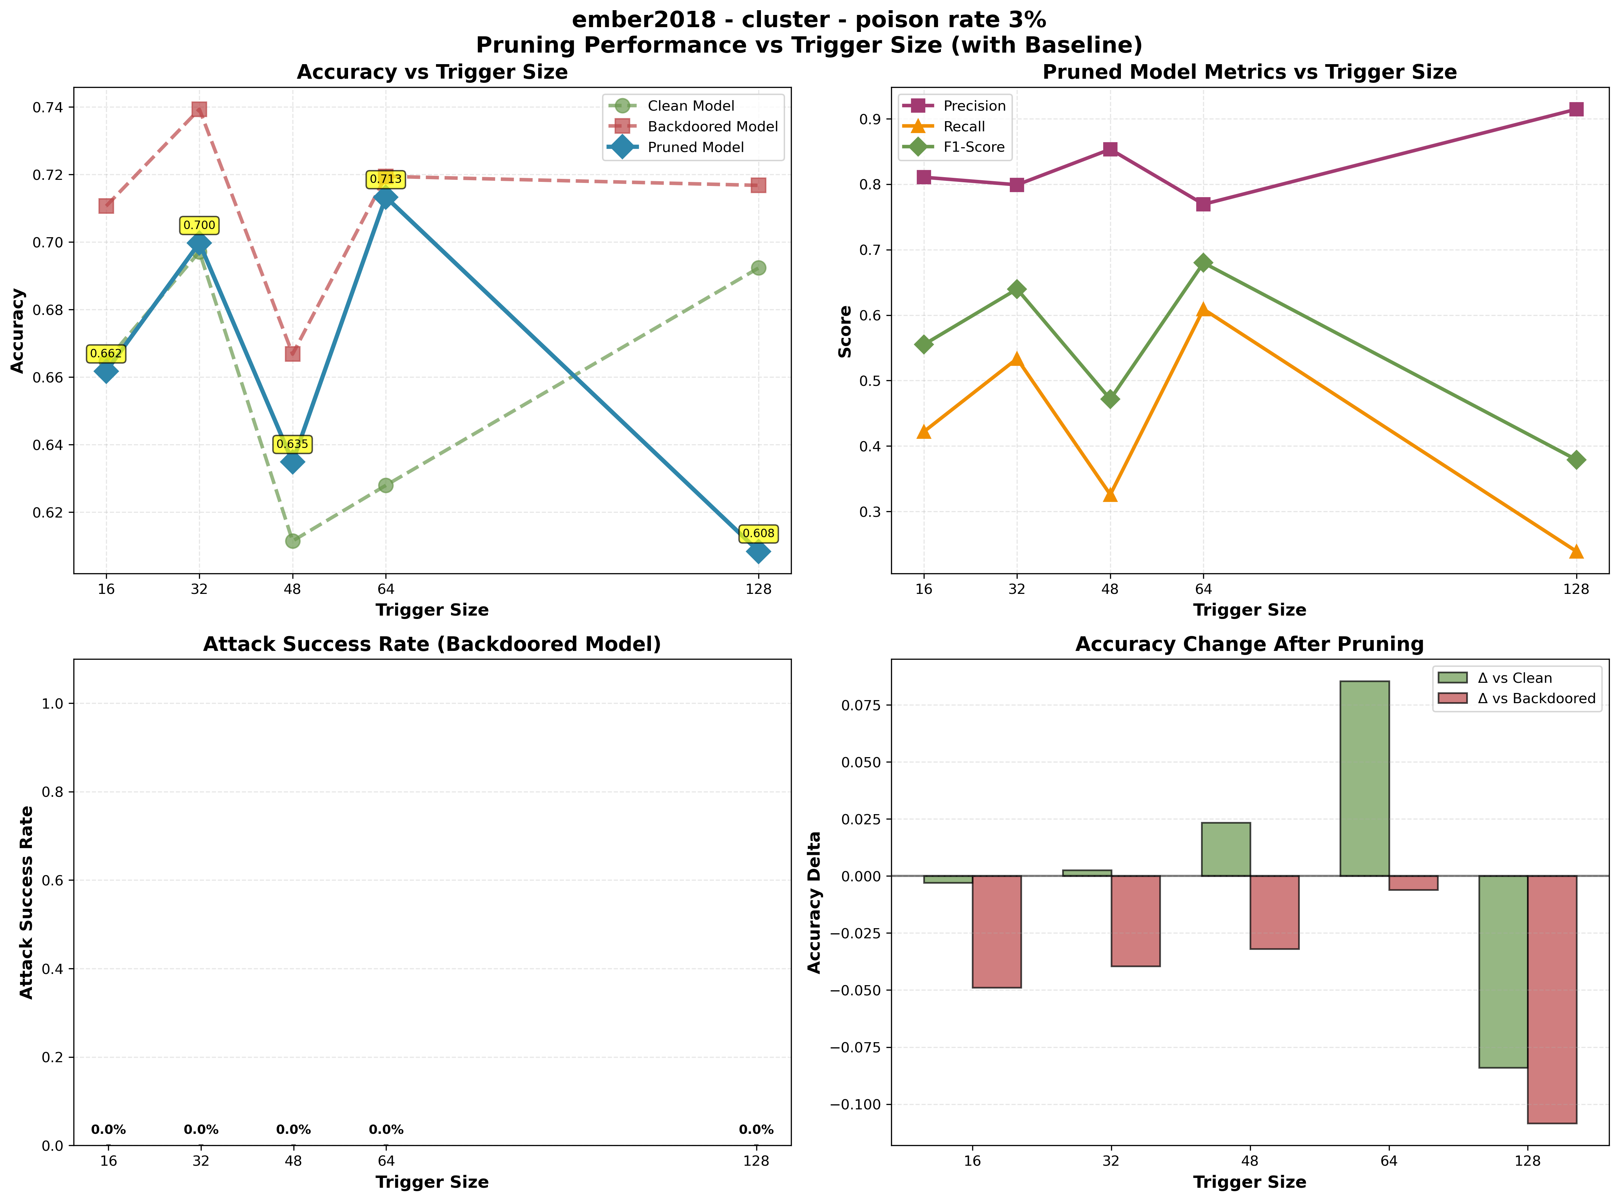
Increasing pruning to detect the better results
PRUNING
Progressive pruning 0–90%
NOISE
Noise injection on weights

Slide 27
Experimental hypothesis
Poisoned samples may:
maintain their influence on the learning process even under noise injection or pruning
continue to be missclassified, behaving as noise-resilient outliers that distort the decision boundary
This because a trained network act as a network with some sub network that has winning lottery ticket

Slide 28
Test pipeline
POISON
PRUNING
Model training on poisoned datasets
Progressive pruning 0–90%
OUTCOME
Graphs and tables are generated to evaluate the effectiveness of the test.
TRAIN
NOISE
ISOLATION FOREST
Clean model training
Noise injection on weights
Detect anomalies in benign samples and remove outliers

Slide 29
Test pipeline
OUTCOME
Graphs and tables are generated to evaluate the effectiveness of the test.
ISOLATION FOREST
Detect anomalies in benign samples and remove outliers

Slide 30



What was analyzed
Performance
Performance Backdoor vs Clean model
Effectiveness
Effectiveness of defenses
Comparison
Comparison of all model

Slide 31

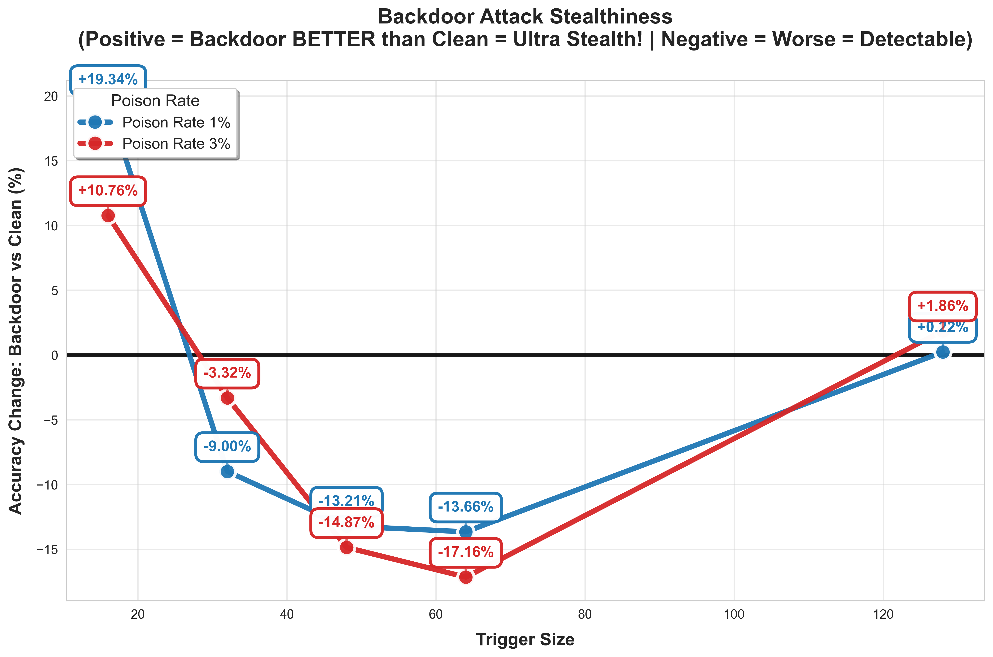
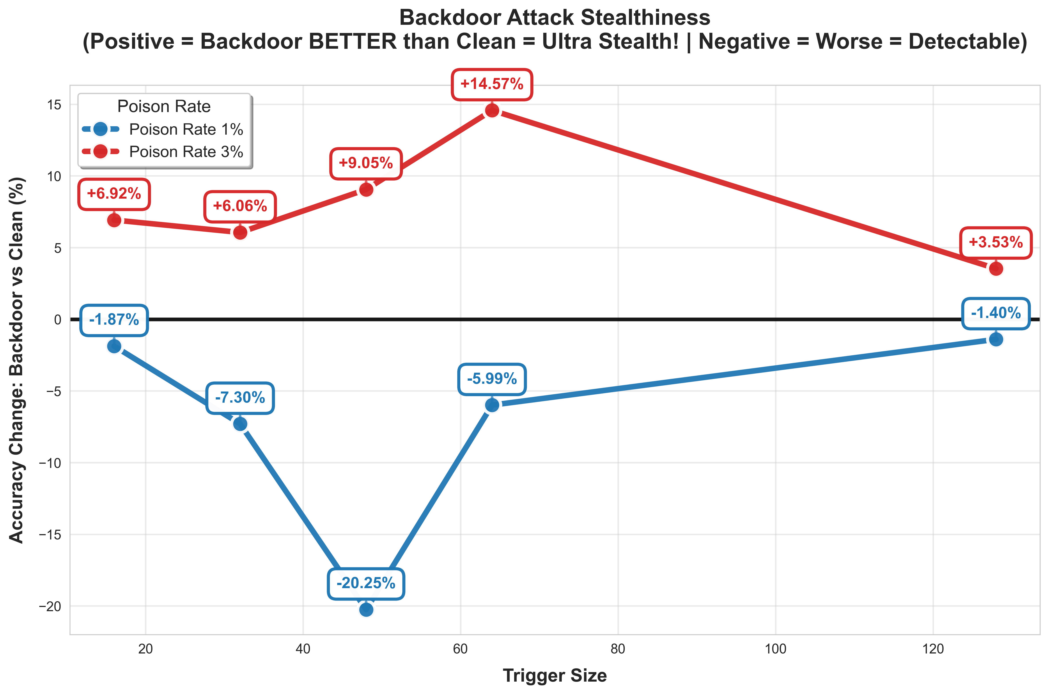

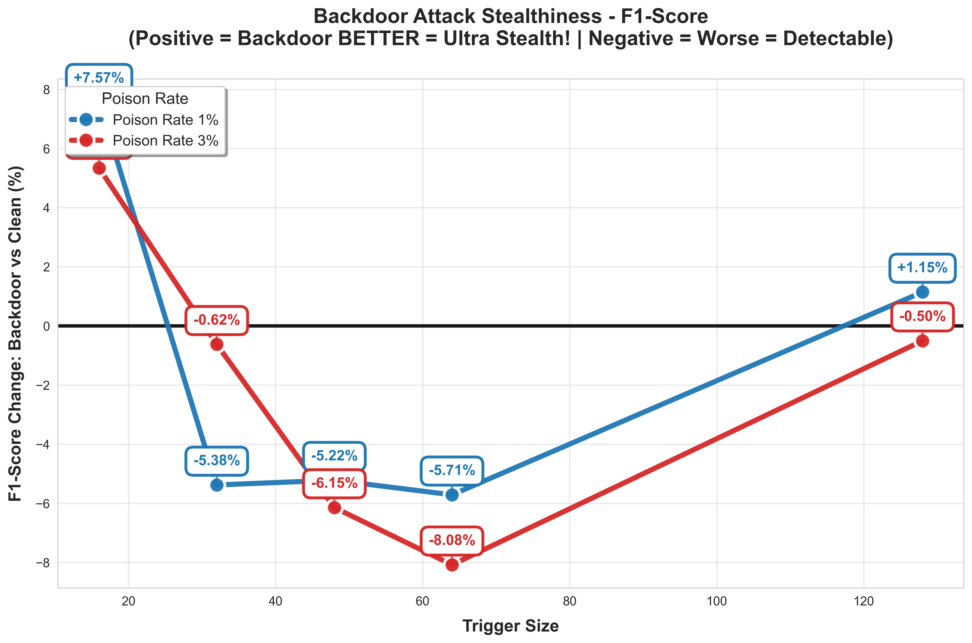
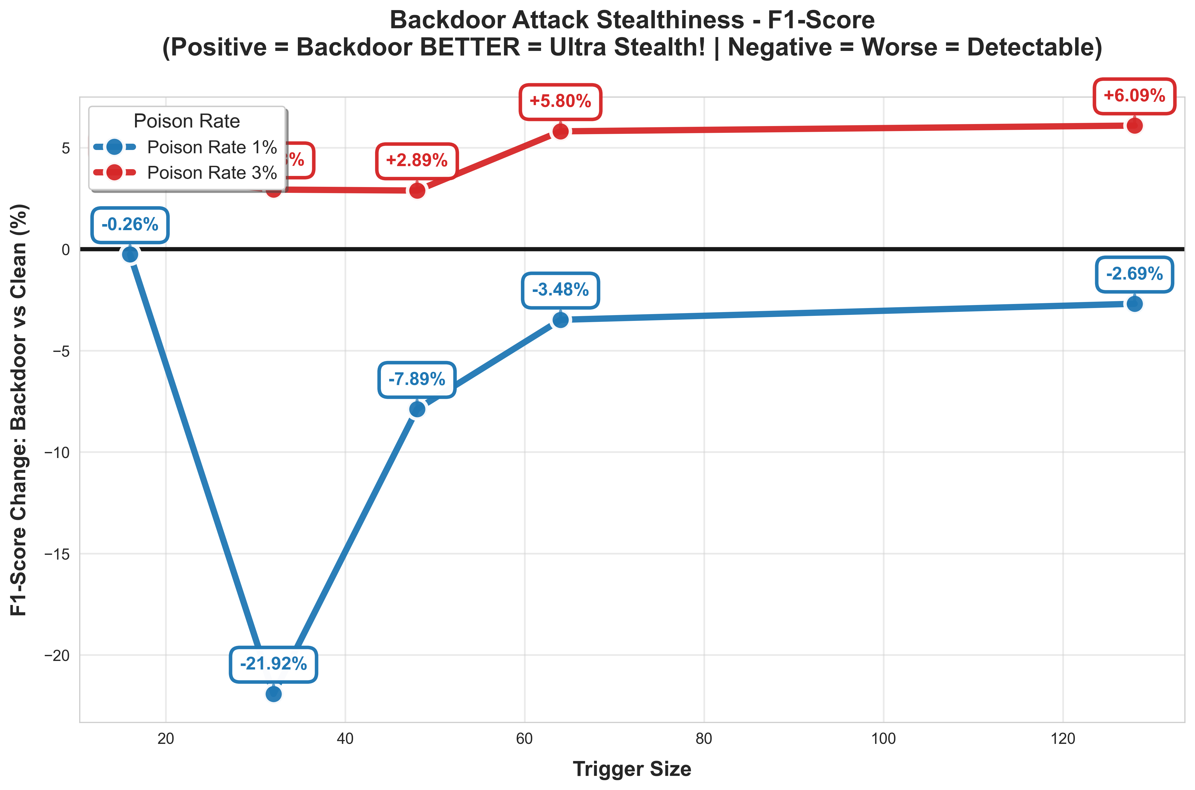

Performance Backdoor vs Clean

Slide 32
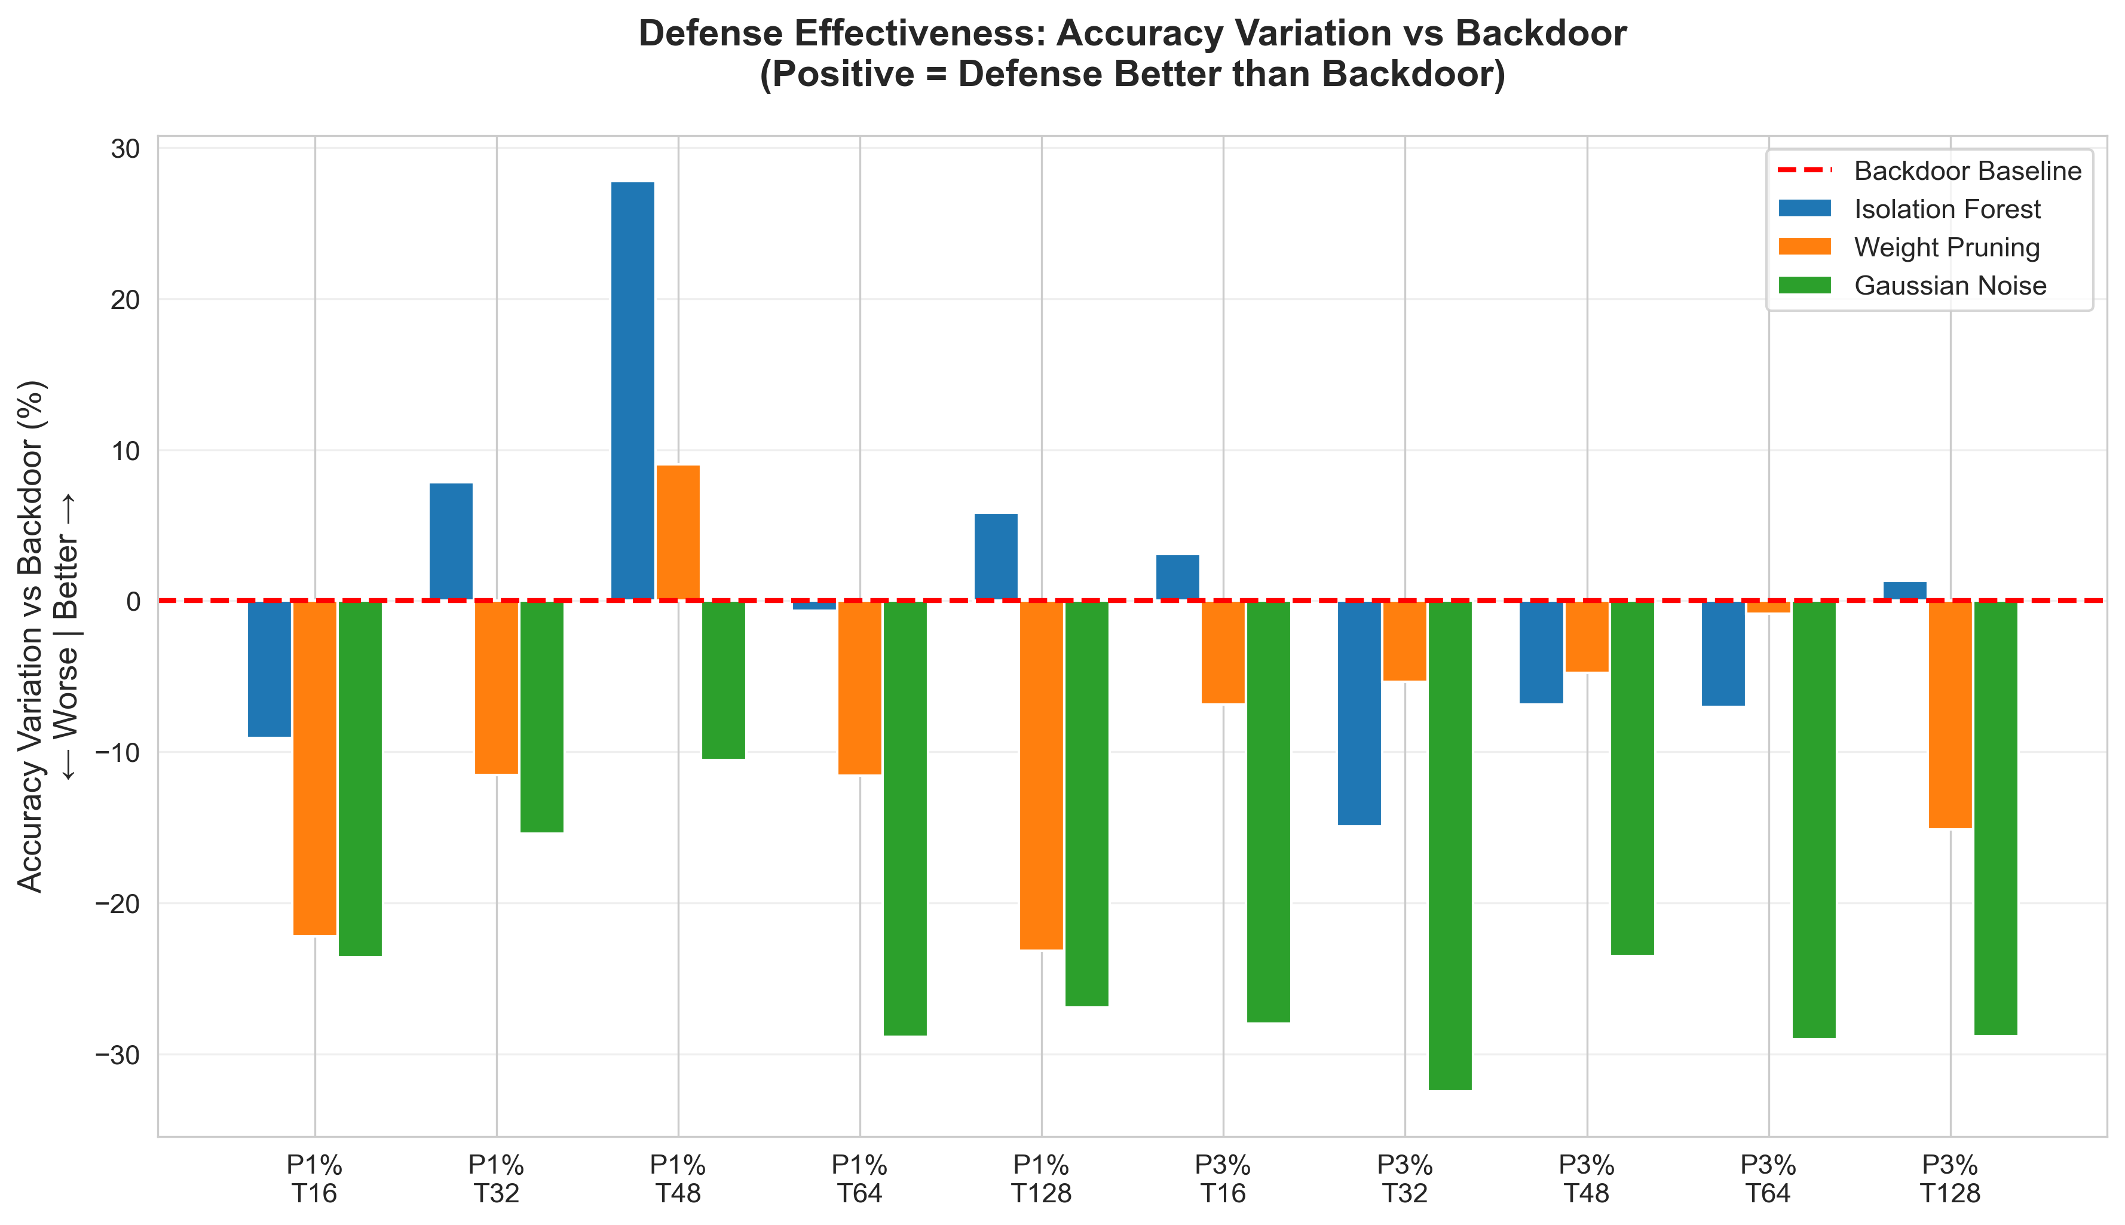
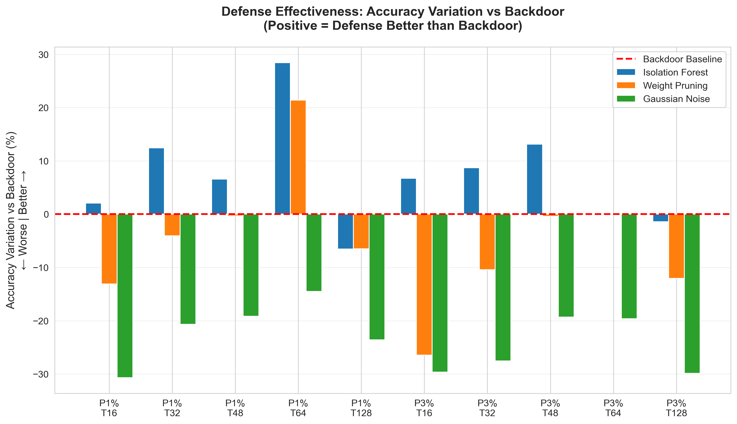
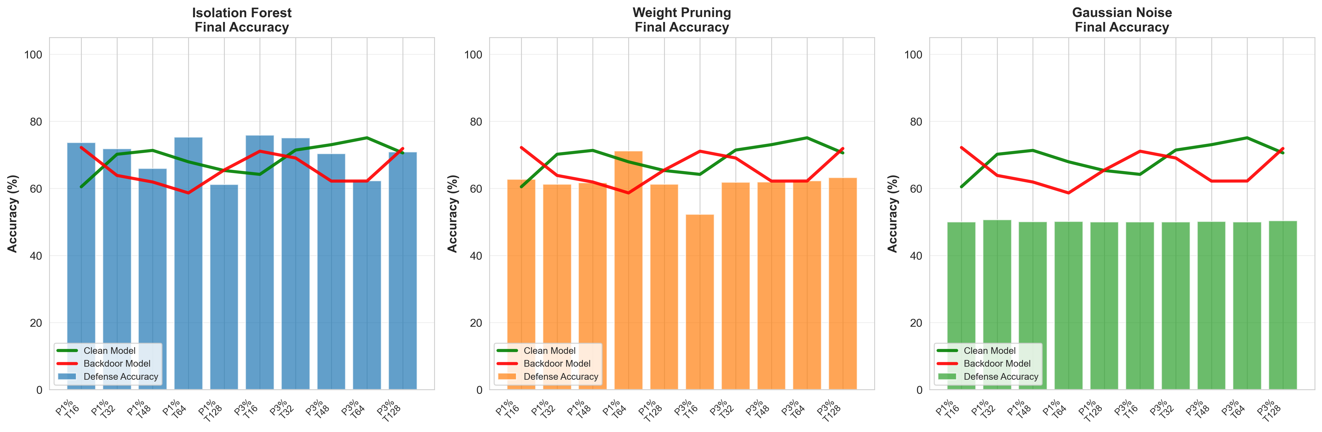
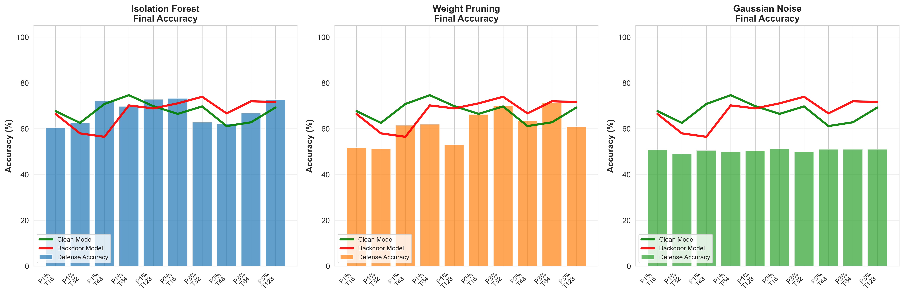
Effectiveness of defense: Accurancy

Slide 33
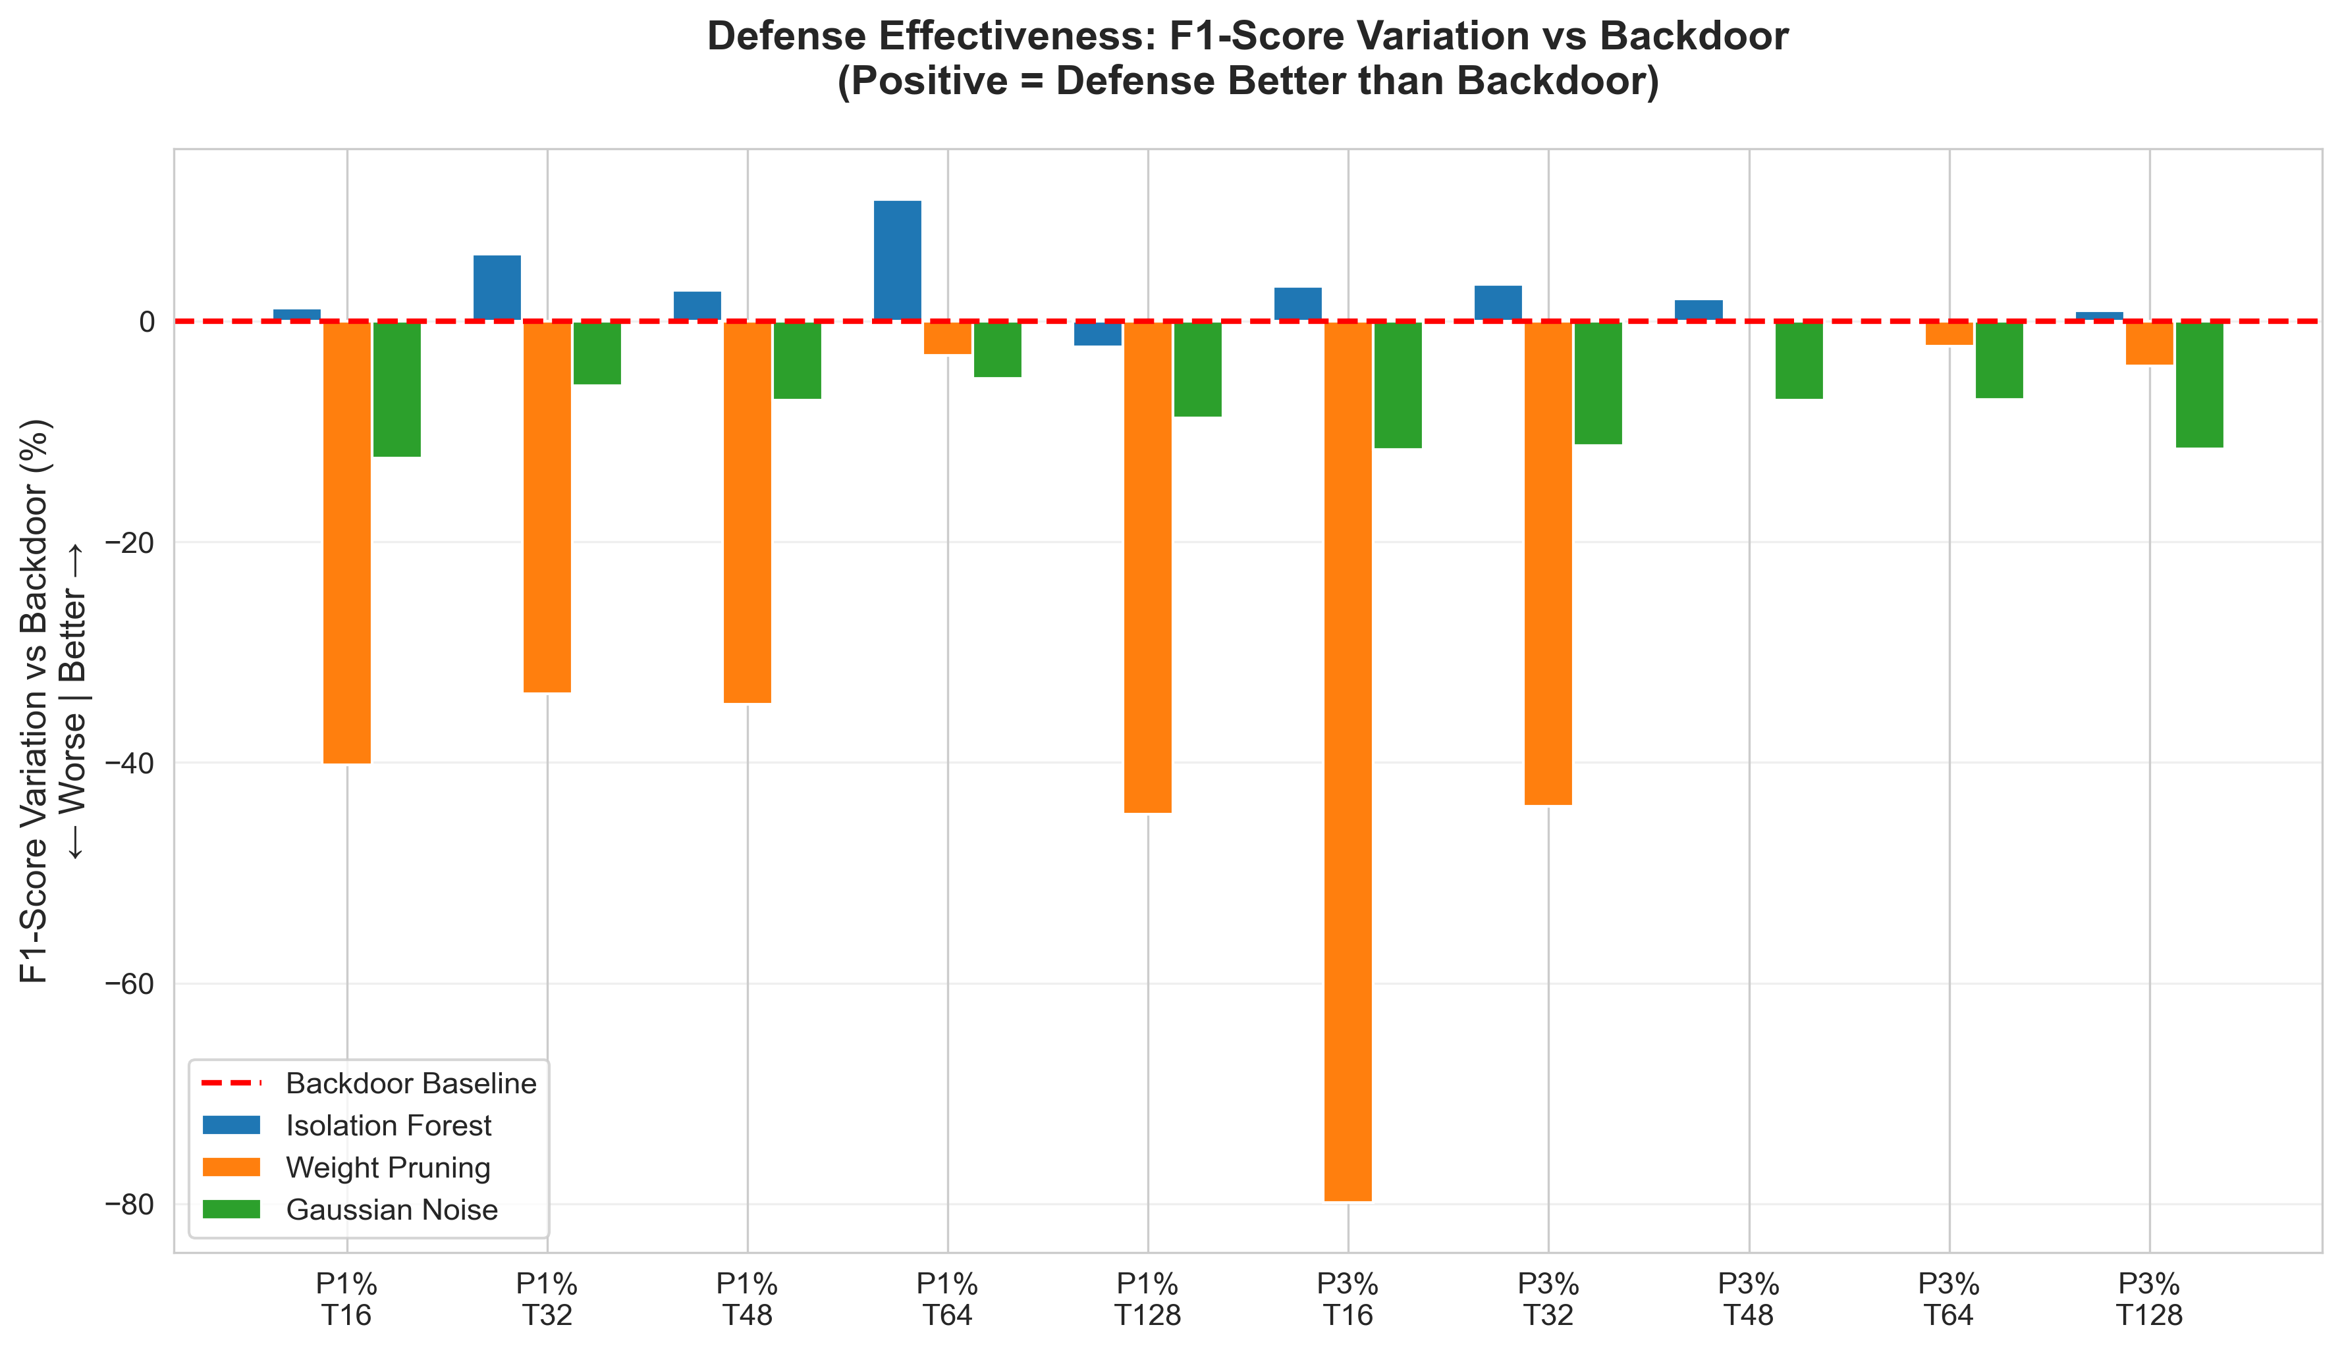
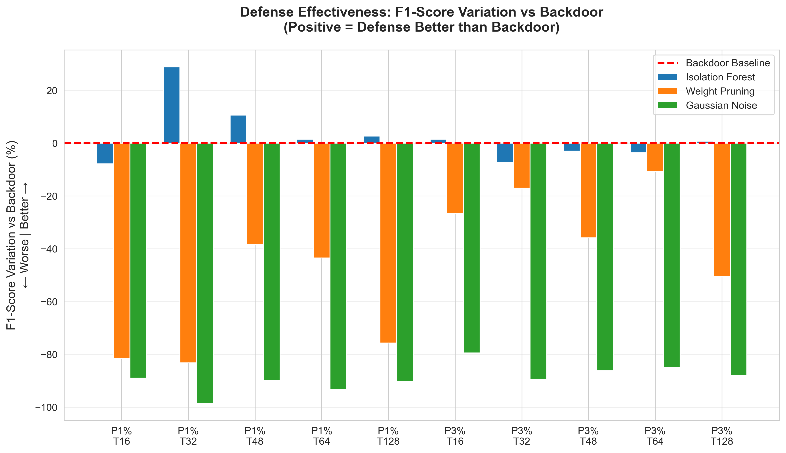
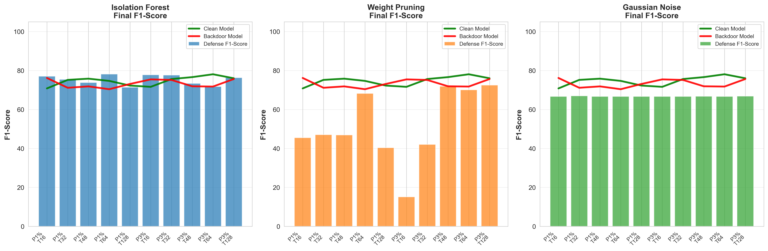
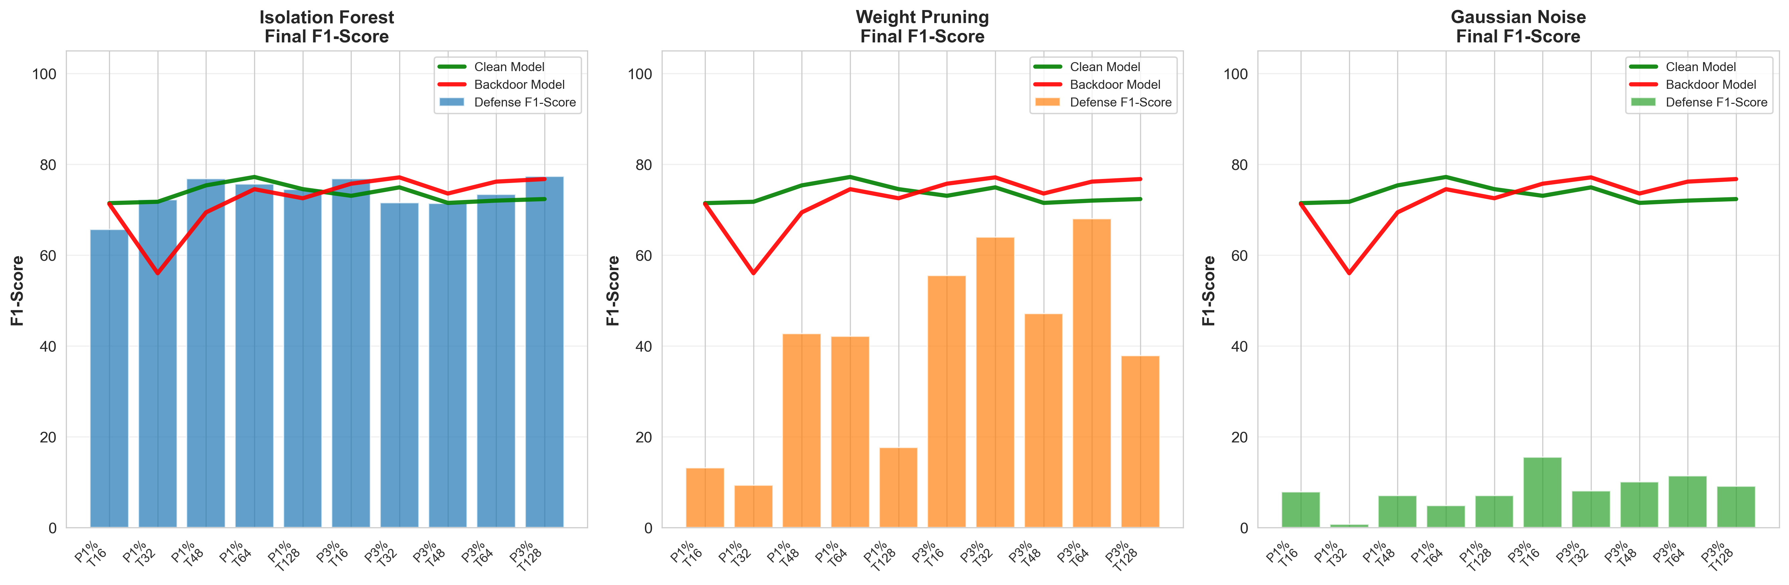
Effectiveness of defense: F1

Slide 34
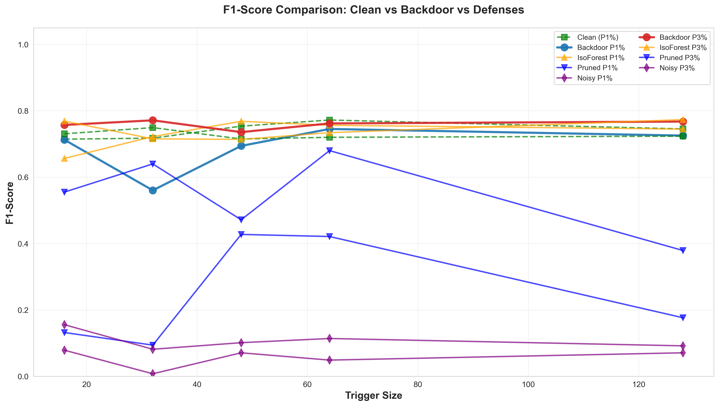
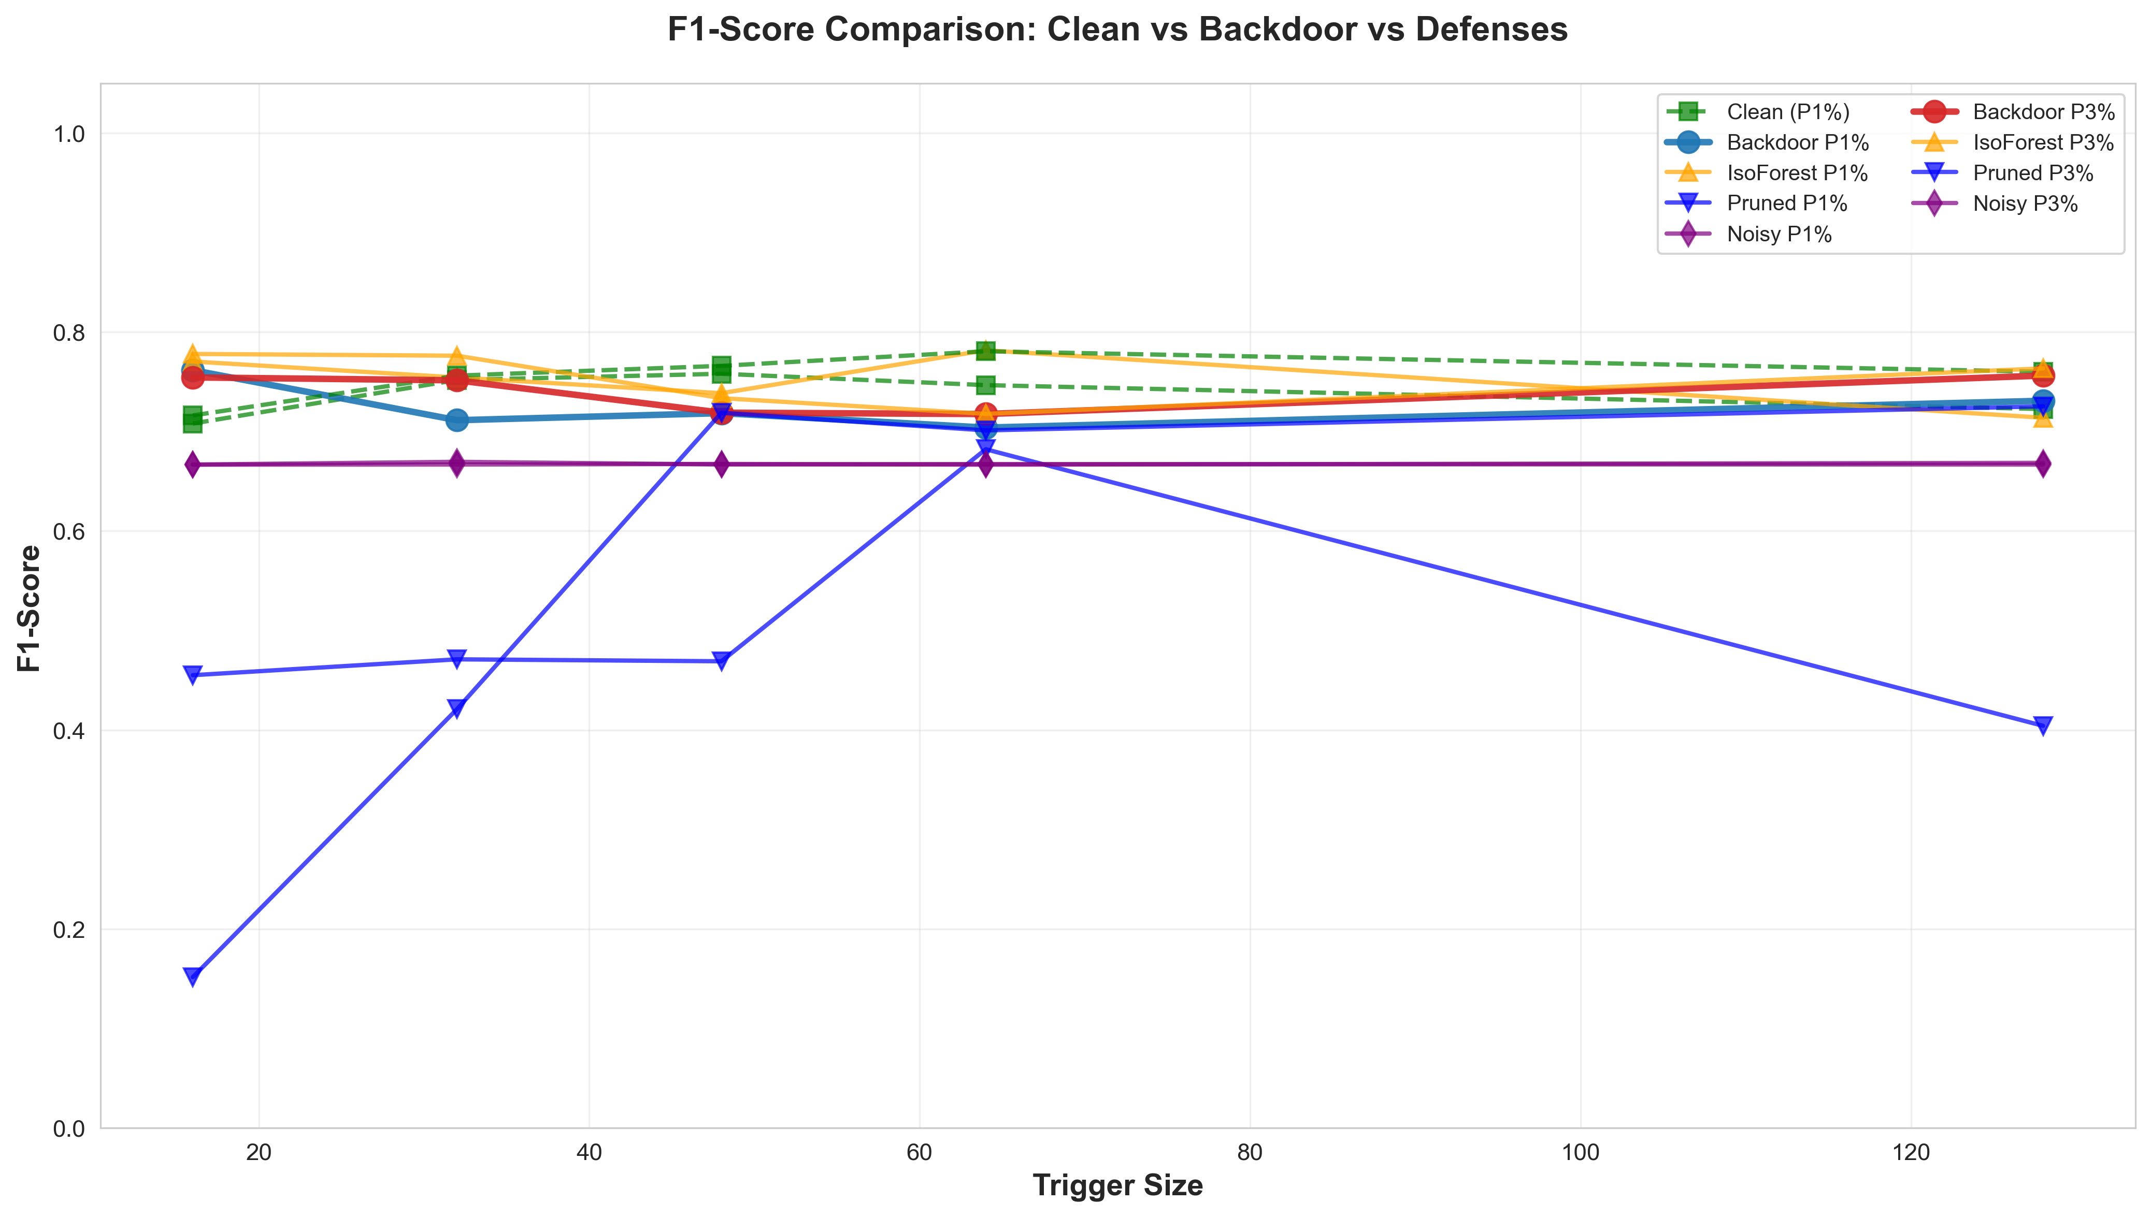
Comparison of all models: F1

Slide 35
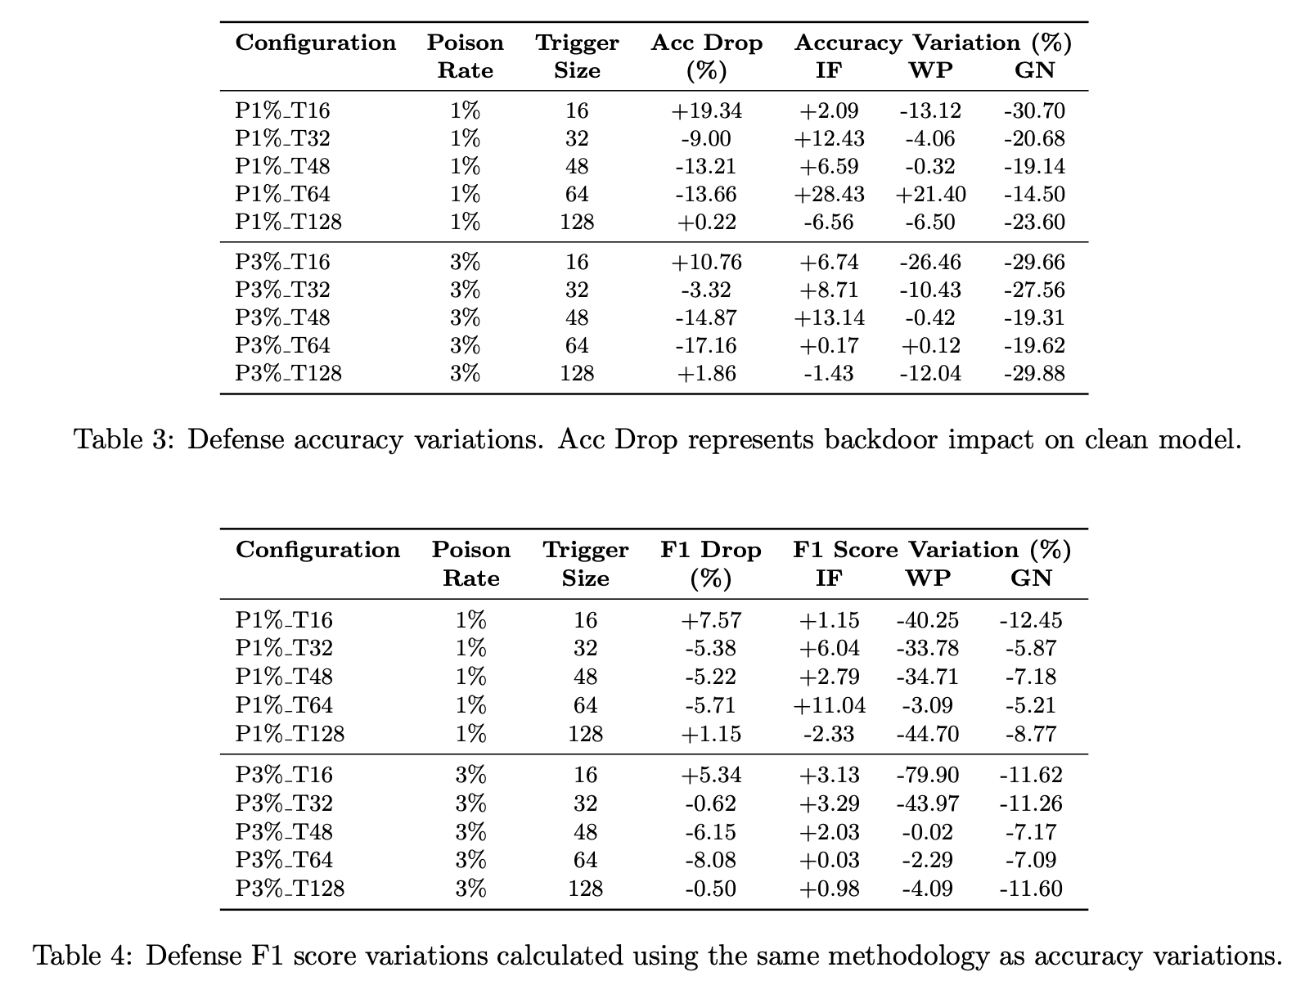
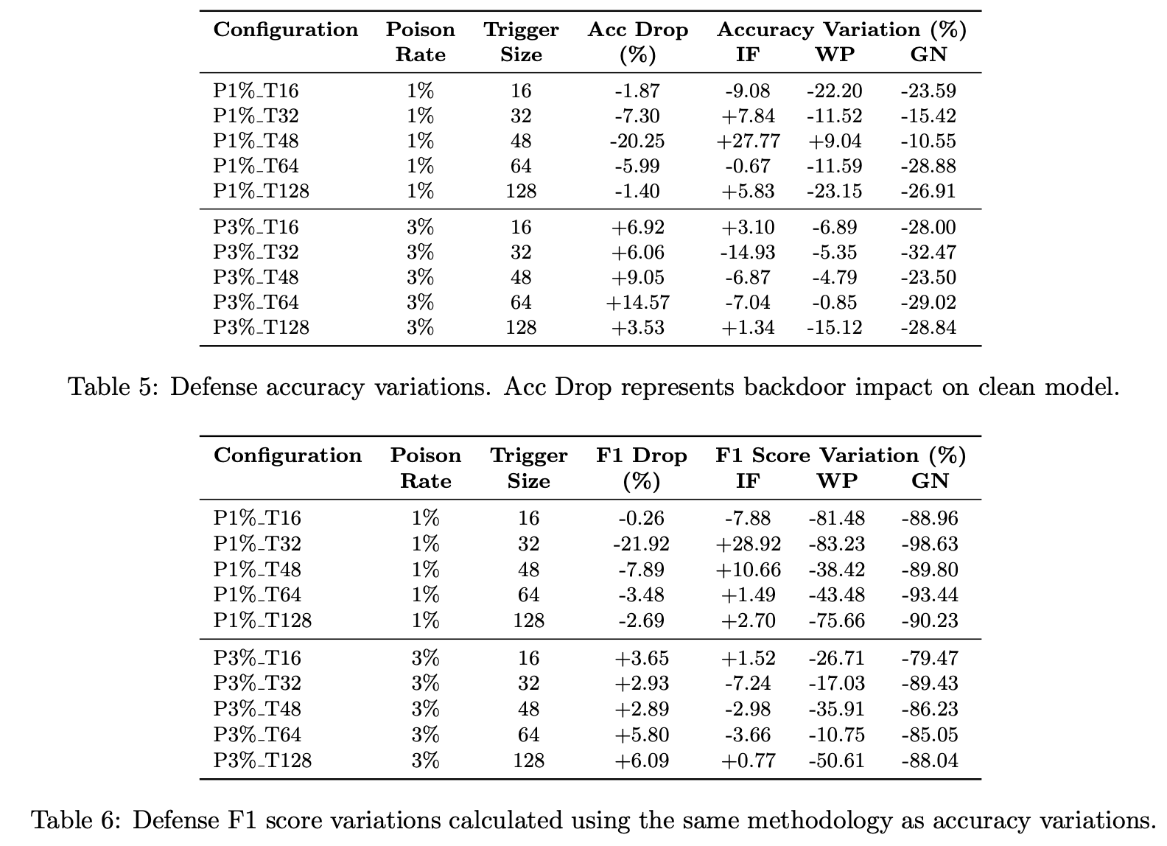
More Data

Slide 36


Raw Data

Slide 37
Cybersecurity Infographics
Positive recovery in most configurations, consistent overall effectiveness | ISOLATION FOREST | Positive recovery in only half of configurations, obvious limitations
Severe uniform degradation, no effective configuration found | GAUSSIAN NOISE | Universal catastrophic collapse, exhaustive parameter search ineffective
Severe F1 collapse, positive recovery in only a minority of configurations | WEIGHT PRUNING | Even worse F1 collapse, only one positive configuration

Slide 38




Conclusions
ENVIRONMENT
BACKDOOR
DEFENSES
IMPLICATION
Interesting phenomena (3% increase, small triggers) warrant further investigation into model optimization.
Computational resources profoundly influence effectiveness and backdoor patterns
Can degrade, improve, or behave non-monotonically depending on configuration
Only Isolation Forest is effective; Pruning is unsuitable, Noise is devastating

Slide 39
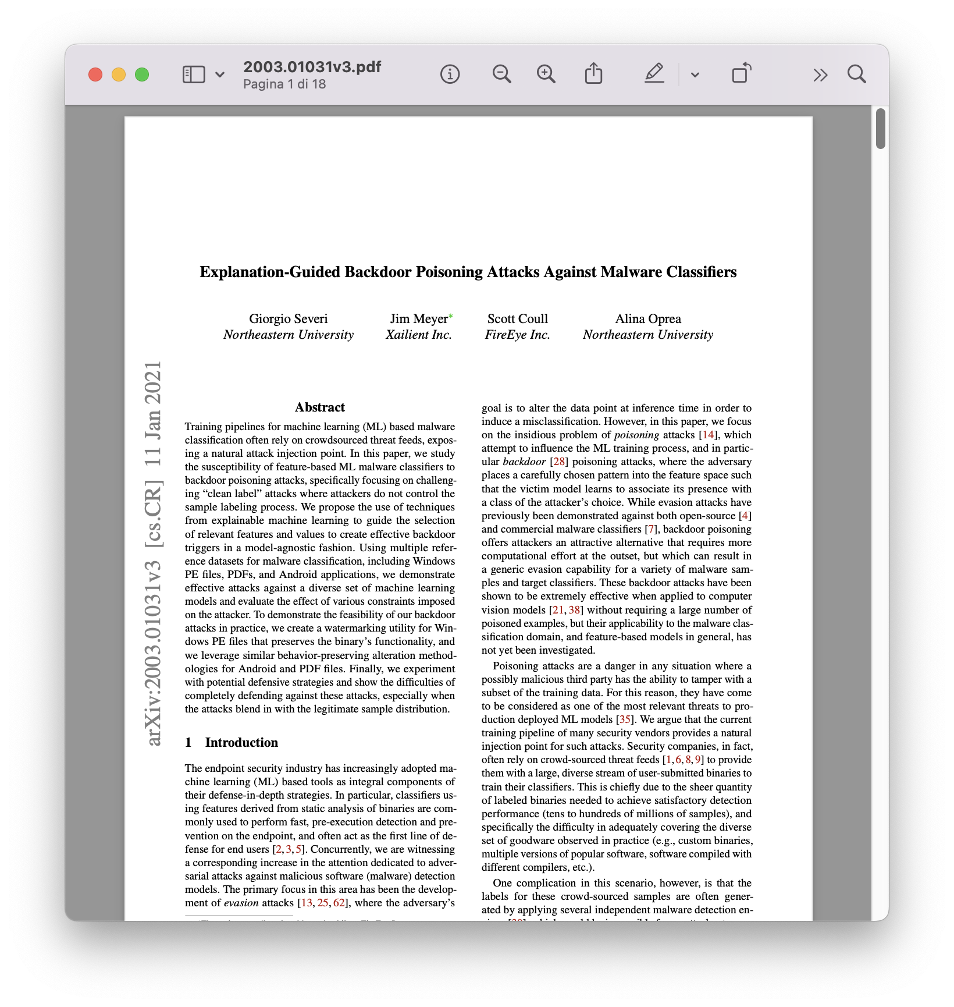
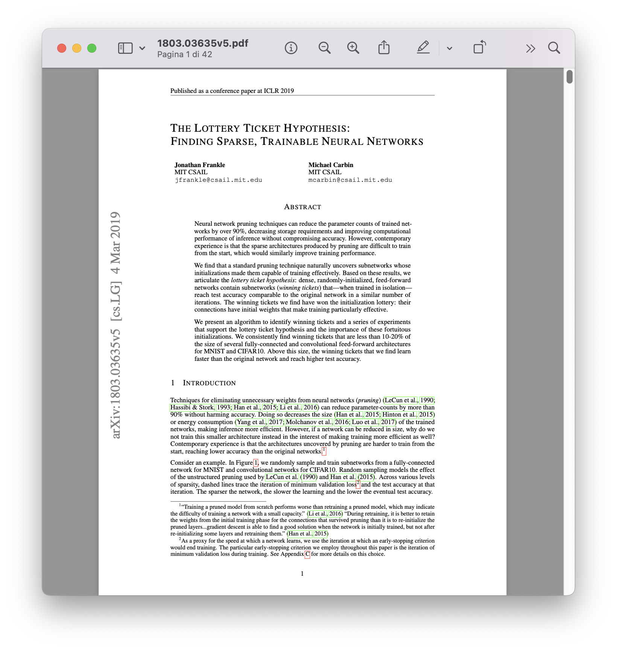
Bibliography

Slide 40

Thanks for the attention

